Slide 1

Sabeel ul Huda
Lesson 40
Surah Al-e-Imran 1-13

Slide 2

Different Names of Surrah....
Al imran---neame of Jesus, grand father of Issa.
AlZuhra--------Shining
Alkunz-------- Treasure
Alistighna----- Sufficient
It have 200 verses, 20 Rukus
2nd biggest surrah.

Slide 3
Surrah alimran . Shana Nazool
We seek ihdina issirat...
Wafad Najran came to
Madinah......
After Ghuzwah Badar, people of book could not oppose islam openly, so they were splited to 3 groups .
Bacame muslim
Did not accept islam
Peace makers... (like doves),
minimising the clash policy live &let to live policy.
Allah swt clear their doubts..

Slide 4
Topic of the verses:
Allah, and the guidance He has sent down to mankind [1-4]
Nothing is hidden from Allah [5-6]
The Mutashabihat and Muhkamat Ayat [7-9]
On the Day of Resurrection, no wealth or offspring shall avail [10-11]
Learn a lesson from the battle of Badr [12-13]

Slide 5
Ayah 1-4
الم ﴿١﴾
اللَّـهُ لَا إِلَـٰهَ إِلَّا هُوَ الْحَيُّ الْقَيُّومُ ﴿٢﴾
نَزَّلَ عَلَيْكَ الْكِتَابَ بِالْحَقِّ مُصَدِّقًا لِمَا بَيْنَ يَدَيْهِ وَأَنْزَلَ التَّوْرَاةَ وَالْإِنْجِيلَ ﴿٣﴾
مِنْ قَبْلُ هُدًى لِلنَّاسِ وَأَنْزَلَ الْفُرْقَانَ ۗ إِنَّ الَّذِينَ كَفَرُوا بِآيَاتِ اللَّـهِ لَهُمْ عَذَابٌ شَدِيدٌ ۗ وَاللَّـهُ عَزِيزٌ ذُو انْتِقَامٍ ﴿٤﴾

Slide 6
Ayah 1-4 - Translation
Alif, Lam, Meem.
Allah - there is no deity except Him, the Ever-Living, the Sustainer of existence.
He has sent down upon you, [O Muhammad], the Book in truth, confirming what was before it. And He revealed the Torah and the Gospel.
Before, as guidance for the people. And He revealed the Qur'an. Indeed, those who disbelieve in the verses of Allah will have a severe punishment, and Allah is exalted in Might, the Owner of Retribution.

Slide 7
Surah Al-e-Imran
Surah Al `Imran was revealed in Al-Madinah.
Allah’s Greatest name is contained in ayah 2.
Only the true Ilaah is the One who lives forever, and the One who sustains everything.
There is no doubt this Quran is from Allah.

Slide 8

”the Torah and the Gospel”…
These Books testify to the truth of the Qur'an, and the Qur'an also testifies to the truth these Books contained, including the news and glad tidings of Muhammad's prophethood and the revelation of the Glorious Qur'an.
Torah, to Prophet Musa.
Injil (the Gospel) to Prophet Isa.
Before the Quran, these books were guidance in their time.

Slide 9
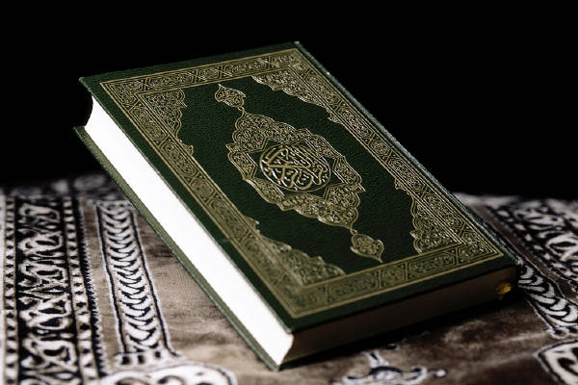
”the criterion” / ”the Furqan”…
“And He revealed the Al-Furqan.”: which is the distinction between misguidance, falsehood and deviation on one hand, and guidance, truth and piety on the other hand.
This is because of the indications, signs, plain evidences and clear proofs that it contains, and because of its explanations, clarifications, etc.

Slide 10
Ayah 5-6
إِنَّ اللَّـهَ لَا يَخْفَىٰ عَلَيْهِ شَيْءٌ فِي الْأَرْضِ وَلَا فِي السَّمَاءِ ﴿٥﴾
هُوَ الَّذِي يُصَوِّرُكُمْ فِي الْأَرْحَامِ كَيْفَ يَشَاءُ ۚ لَا إِلَـٰهَ إِلَّا هُوَ الْعَزِيزُ الْحَكِيمُ ﴿٦﴾

Slide 11
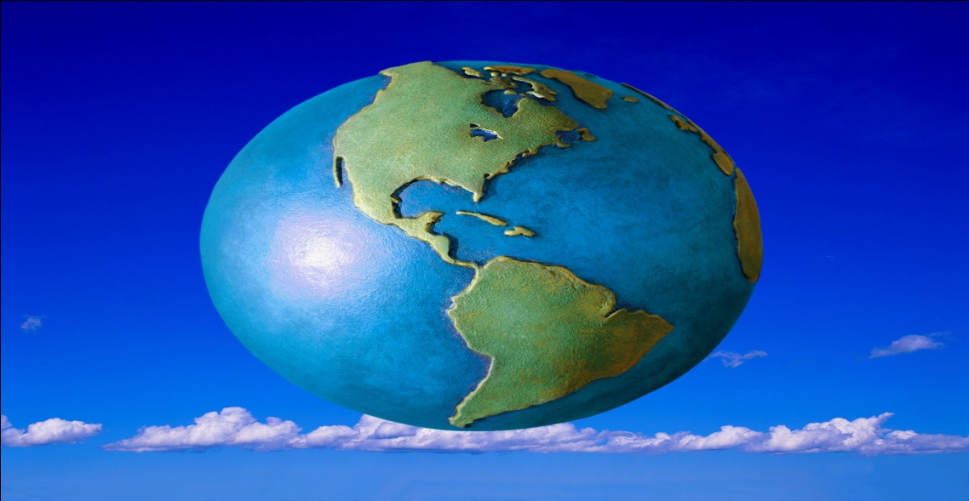
Ayah 5-6 - Translation
Indeed, from Allah nothing is hidden in the earth nor in the heaven.
It is He who forms you in the wombs however He wills. There is no deity except Him, the Exalted in Might, the Wise.

Slide 12

Nothing is hidden from Allah…
Allah states that He has perfect knowledge in the heavens and earth and that nothing in them is hidden from His watch.
He creates you in the wombs as He wills, whether male or female, handsome or otherwise, happy or miserable.

Slide 13
About ayah 6 and Prophet Isa…
He is the Creator and thus is the only deity worthy of worship, without partners, and His is the perfect might, wisdom and decision.
This Ayah refers to the fact that `Isa, son of Mary, is a created servant, just as Allah created the rest of mankind.
Allah created `Isa in the womb (of his mother) and shaped him as He willed.

Slide 14
Ayah 7
هُوَ الَّذِي أَنْزَلَ عَلَيْكَ الْكِتَابَ مِنْهُ آيَاتٌ مُحْكَمَاتٌ هُنَّ أُمُّ الْكِتَابِ وَأُخَرُ مُتَشَابِهَاتٌ ۖ فَأَمَّا الَّذِينَ فِي قُلُوبِهِمْ زَيْغٌ فَيَتَّبِعُونَ مَا تَشَابَهَ مِنْهُ ابْتِغَاءَ الْفِتْنَةِ وَابْتِغَاءَ تَأْوِيلِهِ ۗ وَمَا يَعْلَمُ تَأْوِيلَهُ إِلَّا اللَّـهُ ۗ وَالرَّاسِخُونَ فِي الْعِلْمِ يَقُولُونَ آمَنَّا بِهِ كُلٌّ مِنْ عِنْدِ رَبِّنَا ۗ وَمَا يَذَّكَّرُ إِلَّا أُولُو الْأَلْبَابِ ﴿٧﴾

Slide 15
Ayah 7 - Translation
It is He who has sent down to you, [O Muhammad], the Book; in it are verses [that are] precise - they are the foundation of the Book - and others unspecific. As for those in whose hearts is deviation [from truth], they will follow that of it which is unspecific, seeking discord and seeking an interpretation [suitable to them]. And no one knows its [true] interpretation except Allah . But those firm in knowledge say, "We believe in it. All [of it] is from our Lord." And no one will be reminded except those of understanding.

Slide 16

Muhkamat and Mutashabihat…
Allah states that in the Qur'an, there are Ayat that are Muhkamat, entirely clear and plain, and these are the foundations of the Book which are plain for everyone.
And there are Ayat in the Qur'an that are Mutashabihat not entirely clear for many, or some people.

Slide 17
Muhkamat and Mutashabihat - 2
So those who refer to the Muhkam Ayat to understand the Mutashabih Ayat, will have acquired the correct guidance, and vice versa.
“- they are the foundation of the Book“: meaning, they are the basis of the Qur'an, and should be referred to for clarification, when warranted.
“and others unspecific.”: meaning they have several meanings, some that agree with the Muhkam and some that carry other literal indications.

Slide 18

Muhkamat and Mutashabihat - 3
The Muhkamat are the Ayat that explain the abrogating rulings, the allowed, prohibited, laws, limits, obligations and rulings that should be believed in and implemented.
The Mutashabihat Ayat, they include the abrogated Ayat, parables, oaths, and what should be believed in, but not implemented.

Slide 19
Those who alter the meanings…
“As for those in whose hearts is deviation [from truth], they will follow that of it which is unspecific”: meaning they refer to the Mutashabih, because they are able to alter its meanings to conform with their false interpretation since the wordings of the Mutashabihat encompass such a wide area of meanings.
As for the Muhkam Ayat, they cannot be altered because they are clear and, thus, constitute unequivocal proof against the misguided people.

Slide 20
About Prophet Isa…
For instance, Christians might claim that `Isa is divine because the Qur'an states that he is Ruhullah and His Word, which He gave to Mary, all the while ignoring Allah's statements, as ”(He ﴿`Isa﴾ was not more than a servant. We granted Our favor to him.) ”43:59.
There are other Ayat that clearly assert that `Isa is but one of Allah's creatures and that he is the servant and Messenger of Allah, among other Messengers.

Slide 21

“No one knows its [true] interpretation except Allah…”
Reported from Ibn `Abbas, "Tafsir is of four types: Tafsir that the Arabs know in their language; Tafsir that no one is excused of being ignorant of; Tafsir that the scholars know; and Tafsir that only Allah knows.'‘
Ta'wil has two meanings in the Qur'an, the true reality of things, and what they will turn out to be.

Slide 22
”Those of understanding…”
"We believe in it. All [of it] is from our Lord.“: meaning that the knowledgeable people say that they believe in it, both the Muhkam and the Mutashabih are true and authentic, and each one of them testifies to the truth of the other.
“And no one will be reminded except those of understanding.”: meaning , those who have good minds and sound comprehension, understand, contemplate and comprehend the meaning in the correct manner.

Slide 23
Ayah 8-9
رَبَّنَا لَا تُزِغْ قُلُوبَنَا بَعْدَ إِذْ هَدَيْتَنَا وَهَبْ لَنَا مِنْ لَدُنْكَ رَحْمَةً ۚ إِنَّكَ أَنْتَ الْوَهَّابُ ﴿٨﴾
رَبَّنَا إِنَّكَ جَامِعُ النَّاسِ لِيَوْمٍ لَا رَيْبَ فِيهِ ۚ إِنَّ اللَّـهَ لَا يُخْلِفُ الْمِيعَادَ ﴿٩﴾

Slide 24
Ayah 8-9 - Translation
[Who say], "Our Lord, let not our hearts deviate after You have guided us and grant us from Yourself mercy. Indeed, You are the Bestower.
Our Lord, surely You will gather the people for a Day about which there is no doubt. Indeed, Allah does not fail in His promise."

Slide 25
A supplication…
Those of understanding and knowledge supplicate to Allah: Do not deviate our hearts from the guidance after You allowed them to acquire it. Do not make us like those who have wickedness in their hearts, those who follow the Mutashabih in the Qur'an. Rather, make us remain firmly on Your straight path and true religion.
The Prophet used to supplicate:
«يَا مُقَلِّبَ الْقُلُوبِ ثَبِّتْ قَلْبِي عَلَى دِينِك»
“O You Who changes the hearts, make my heart firm on Your religion.”

Slide 26
Ayah 10-11
إِنَّ الَّذِينَ كَفَرُوا لَنْ تُغْنِيَ عَنْهُمْ أَمْوَالُهُمْ وَلَا أَوْلَادُهُمْ مِنَ اللَّـهِ شَيْئًا ۖ وَأُولَـٰئِكَ هُمْ وَقُودُ النَّارِ ﴿١٠﴾
كَدَأْبِ آلِ فِرْعَوْنَ وَالَّذِينَ مِنْ قَبْلِهِمْ ۚ كَذَّبُوا بِآيَاتِنَا فَأَخَذَهُمُ اللَّـهُ بِذُنُوبِهِمْ ۗ وَاللَّـهُ شَدِيدُ الْعِقَابِ ﴿١١﴾

Slide 27
Ayah 10-11 - Translation
Indeed, those who disbelieve - never will their wealth or their children avail them against Allah at all. And it is they who are fuel for the Fire.
[Theirs is] like the custom of the people of Pharaoh and those before them. They denied Our signs, so Allah seized them for their sins. And Allah is severe in penalty.

Slide 28
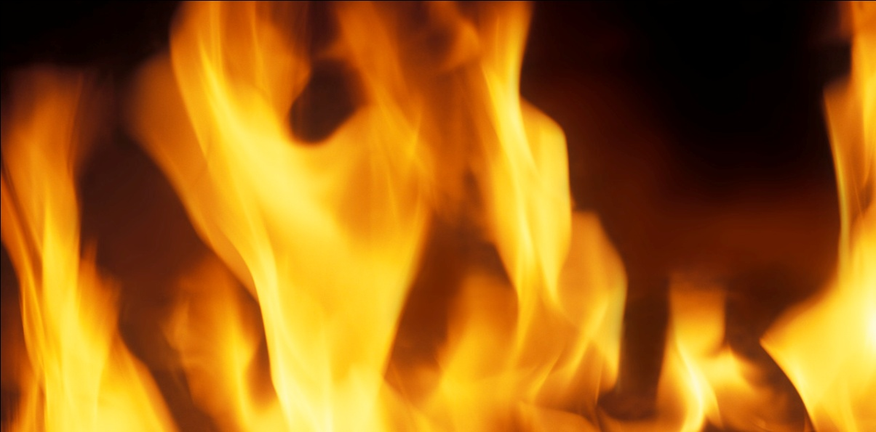
About the disbelievers…
Allah states that the disbelievers shall be fuel for the Fire, what they were granted in this life of wealth and offspring shall not avail them with Allah, or save them from His punishment and severe torment.

Slide 29
”the people of Pharaoh and those before them.”
The Da'b means practice, behavior, tradition and habit.
The Ayah indicates that the disbelievers will not benefit from their wealth or offspring. Rather, they will perish and be punished.
This is the same end the people of Fir`awn and the previous nations met, those who rejected the Messengers, the Ayat, and proofs of Allah that they were sent with.

Slide 30
Ayah 12 - 13
قُلْ لِلَّذِينَ كَفَرُوا سَتُغْلَبُونَ وَتُحْشَرُونَ إِلَىٰ جَهَنَّمَ ۚ وَبِئْسَ الْمِهَادُ ﴿١٢﴾
قَدْ كَانَ لَكُمْ آيَةٌ فِي فِئَتَيْنِ الْتَقَتَا ۖ فِئَةٌ تُقَاتِلُ فِي سَبِيلِ اللَّـهِ وَأُخْرَىٰ كَافِرَةٌ يَرَوْنَهُمْ مِثْلَيْهِمْ رَأْيَ الْعَيْنِ ۚ وَاللَّـهُ يُؤَيِّدُ بِنَصْرِهِ مَنْ يَشَاءُ ۗ إِنَّ فِي ذَٰلِكَ لَعِبْرَةً لِأُولِي الْأَبْصَارِ ﴿١٣﴾

Slide 31
Ayah 12-13 - Translation
Say to those who disbelieve, "You will be overcome and gathered together to Hell, and wretched is the resting place."
Already there has been for you a sign in the two armies which met - one fighting in the cause of Allah and another of disbelievers. They saw them [to be] twice their [own] number by [their] eyesight. But Allah supports with His victory whom He wills. Indeed in that is a lesson for those of vision.

Slide 32
A warning for the Jews…
When the Messenger of Allah gained victory in the battle of Badr and went back to Al-Madinah, he gathered the Jews in the marketplace of Bani Qaynuqa, and therefor Allah said: “Already there has been for you a sign…”
Allah will make His religion prevail, award victory to His Messenger, make His Word apparent and His religion the highest.

Slide 33
The battle of Badr…
” They saw them [to be] twice their [own] number by [their] eyesight. “: meaning the Muslims saw twice as many idolators as they were, yet Allah gave them victory over the disbelievers.
This should be an example for those who have intelligence and sound comprehension. They should contemplate about Allah's wisdom, decisions and decree, that He gives victory to His believing servants in this life and on the Day of Resurrection.

Slide 34
Activity for this lesson…

Slide 35
