Slide 1

Sabeel ul Huda Lesson 37
Sood Kala Dhun
Surah Al-Baqarah: 275-281

Slide 2
Topic of verses
The punishment for dealing with Riba (Interest) [275]
Allah does not bless Riba [276]
The reward of the believers [277]
Having taqwa and avoiding Riba [278]
Riba leads to war against Allah and His messenger [279]
Being kind to debtors who face difficulties [280]
Fear the day of Judgement [281]

Slide 3
Verse 275
﴿الَّذِينَ يَأْكُلُونَ الرِّبَواْ لاَ يَقُومُونَ إِلاَّ كَمَا يَقُومُ الَّذِى يَتَخَبَّطُهُ الشَّيْطَـنُ مِنَ الْمَسِّ ذَلِكَ بِأَنَّهُمْ قَالُواْ إِنَّمَا الْبَيْعُ مِثْلُ الرِّبَواْ وَأَحَلَّ اللَّهُ الْبَيْعَ وَحَرَّمَ الرِّبَواْ فَمَن جَآءَهُ مَوْعِظَةٌ مِّنْ رَّبِّهِ فَانتَهَى فَلَهُ مَا سَلَفَ وَأَمْرُهُ إِلَى اللَّهِ وَمَنْ عَادَ فَأُوْلَـئِكَ أَصْحَـبُ النَّارِ هُمْ فِيهَا خَـلِدُونَ ﴾

Slide 4
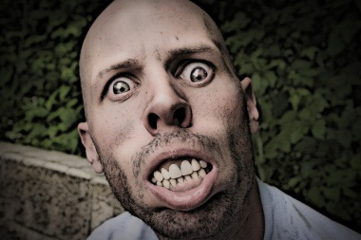
Verse 275 - Translation
Those who consume interest cannot stand [on the Day of Resurrection] except as one stands who is being beaten by Satan into insanity. That is because they say, "Trade is [just] like interest." But Allah has permitted trade and has forbidden interest. So whoever has received an admonition from his Lord and desists may have what is past, and his affair rests with Allah . But whoever returns to [dealing in interest or usury] - those are the companions of the Fire; they will abide eternally therein.

Slide 5
About Riba (interest)…
This Ayah means, on the Day of Resurrection, these people will get up from their graves just as the person afflicted by insanity or possesed by a demon would.
"Trade is [just] like interest.“: the disbelievers said that “they are similar, so why did Allah allow this, but did not allow that.”
Those who have knowledge that Allah made riba unlawful, and refrain from it as soon as they know, then Allah will forgive their previous dealings in Riba.

Slide 6
The lawful and unlawful…
The Shari`ah supports the rule that for any matter that is unlawful, then the means to it are also unlafwful.
Hadith: Both lawful and unlawful things are evident, but in between them there are matters that are not clear.
Leave that which makes you doubt for that which does not make you doubt.

Slide 7
Verse 276-277
﴿يَمْحَقُ اللَّهُ الْرِّبَواْ وَيُرْبِى الصَّدَقَـتِ وَاللَّهُ لاَ يُحِبُّ كُلَّ كَفَّارٍ أَثِيمٍ –
إِنَّ الَّذِينَ ءَامَنُواْ وَعَمِلُواْ الصَّـلِحَـتِ وَأَقَامُواْ الصَّلَوةَ وَآتَوُاْ الزَّكَوةَ لَهُمْ أَجْرُهُمْ عِندَ رَبِّهِمْ وَلاَ خَوْفٌ عَلَيْهِمْ وَلاَ هُمْ يَحْزَنُونَ ﴾

Slide 8
Verse 276-277 - Translation
Allah destroys interest and gives increase for charities. And Allah does not like every sinning disbeliever.
Indeed, those who believe and do righteous deeds and establish prayer and give zakah will have their reward with their Lord, and there will be no fear concerning them, nor will they grieve.

Slide 9
Continued..ayah 276-277
Allah states that He destroys Riba, either by removing this money from those who eat it, or by depriving them of the blessing of it.
Allah increases charity and makes it grow.
Allah praised those who believe in His Lordship, obey His commands, thank Him and appreciate Him. They are those who are kind to His creation, establish prayer and give charity due on their money.

Slide 10
Verse 278-279
﴿يأَيُّهَا الَّذِينَ ءَامَنُواْ اتَّقُواْ اللَّهَ وَذَرُواْ مَا بَقِىَ مِنَ الرِّبَواْ إِن كُنتُمْ مُّؤْمِنِينَ ﴾
﴿فَإِن لَّمْ تَفْعَلُواْ فَأْذَنُواْ بِحَرْبٍ مِّنَ اللَّهِ وَرَسُولِهِ وَإِن تُبتُمْ فَلَكُمْ رُءُوسُ أَمْوَلِكُمْ لاَ تَظْلِمُونَ وَلاَ تُظْلَمُونَ -

Slide 11
Verse 278-279 - Translation
O you who have believed, fear Allah and give up what remains [due to you] of interest, if you should be believers.
And if you do not, then be informed of a war [against you] from Allah and His Messenger. But if you repent, you may have your principal - [thus] you do no wrong, nor are you wronged.

Slide 12
Fear Allah & abandon the Riba
Allah commands His believing servants to fear Him.
“give up what remains” means: abandon the Riba that people still owe you upon hearing this warning.
This Ayah was revealed about two tribes who became Muslims, but had leftover Riba from time of jahiliyyah.

Slide 13
More about ayah 279…
Ayah 279 serves as a strong threat to those who continue to deal in Riba after Allah revealed this warning.
The Messenger of Allah SAW said a speech during the farewell Hajj: “Verily, every case of Riba from the Jahiliyyah is completely annulled. You will only take back your capital, without increase or decrease. The first Riba that I annul is the Riba of Al-`Abbas bin `Abdul-Muttalib, all of it is annulled.”

Slide 14
Verse 280-281
وَإِن كَانَ ذُو عُسْرَةٍ فَنَظِرَةٌ إِلَى مَيْسَرَةٍ وَأَن تَصَدَّقُواْ خَيْرٌ لَّكُمْ إِن كُنتُمْ تَعْلَمُونَ ﴾
وَاتَّقُواْ يَوْمًا تُرْجَعُونَ فِيهِ إِلَى اللَّهِ ثُمَّ تُوَفَّى كُلُّ نَفْسٍ مَّا كَسَبَتْ وَهُمْ لاَ يُظْلَمُونَ-﴾

Slide 15
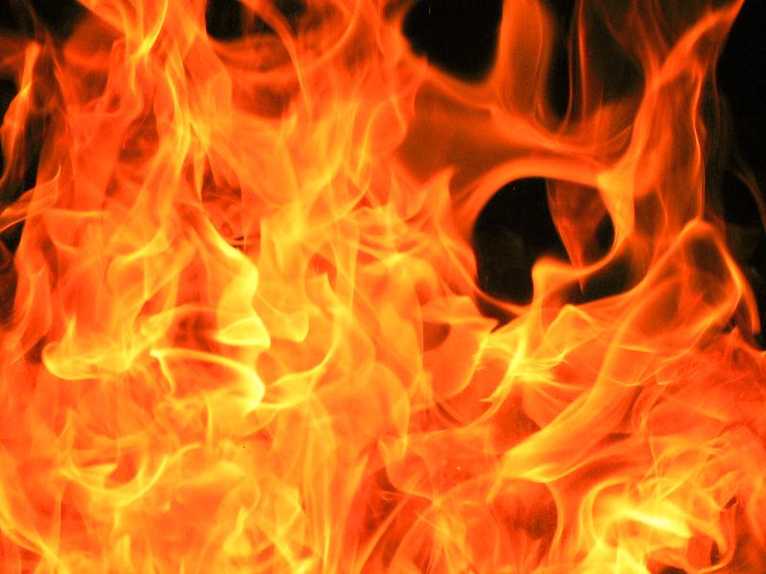
Verse 280-281 - Translation
And if someone is in hardship, then [let there be] postponement until [a time of] ease. But if you give [from your right as] charity, then it is better for you, if you only knew.
And fear a Day when you will be returned to Allah. Then every soul will be compensated for what it earned, and they will not be treated unjustly.

Slide 16
Being kind to debtors…
Allah commands creditors to be patient with debtors who are having a hard time financially.
“But if you give [from your right as] charity” means: if you let go of the debt, and cancel it completely.
Hadith: Whoever gives time to a debtor facing hard times, will gain charity of equal proportions for each day he gives.

Slide 17
Hadith…
On the Day of Resurrection, one of Allah's servants will be summoned before Him and He will ask him, "What deeds did you perform for Me in your life'' He will say, "O Lord! In my life, I have not performed a deed for Your sake that equals an atom,'' three times. The third time, the servant will add, "O Lord! You granted me wealth and I used to be a merchant. I used to be lenient, giving easy terms to those well-off and giving time to the debtors who faced hard times.'' Allah will say, "I Am the Most Worthy of giving easy terms. Therefore, enter Paradise.''

Slide 18
The Day when you will return to Allah…
Allah further advised His servants, by reminding them that this life will soon end and all the wealth in it will vanish.
The Hereafter will surely come, when the Return to Him will occur, and that He will hold His creation accountable for what they did.
It was reported that Ayah 281 was the last Ayah revealed from the Glorious Qur'an.

Slide 19

Activity for this lesson…

Slide 20
