Slide 1

Sabeel ul Huda
Lesson 45
Surah Al-e-Imran – 64-77

Slide 2
Topic of the verses:
Dawah to Ahl-e-Kitaab [65]
The false claims of Ahl-e-Kitaab about hz. Ibrahim [65-68]
A faction of the jews tried to create doubts about Islam [69-71]
Their evil plan exposed [72]
The false hopes of the jews, and the response to it [73-74]
Good and bad qualities in Ahl-e-Kitaab [75-76]
Punishment for the one who breaks covenants and oaths [77]

Slide 3
Ayah 64
﴿قُلْ يأَهْلَ الْكِتَـبِ تَعَالَوْاْ إِلَى كَلِمَةٍ سَوَآءٍ بَيْنَنَا وَبَيْنَكُمْ أَلاَّ نَعْبُدَ إِلاَّ اللَّهَ وَلاَ نُشْرِكَ بِهِ شَيْئاً وَلاَ يَتَّخِذَ بَعْضُنَا بَعْضًا أَرْبَابًا مِّن دُونِ اللَّهِ فَإِن تَوَلَّوْاْ فَقُولُواْ اشْهَدُواْ بِأَنَّا مُسْلِمُونَ ﴾

Slide 4
Ayah 64 - Translation
Say, "O People of the Scripture, come to a word that is equitable between us and you - that we will not worship except Allah and not associate anything with Him and not take one another as lords instead of Allah ." But if they turn away, then say, "Bear witness that we are Muslims [submitting to Him]."

Slide 5
Ayah 64 – Background....
This ayat is answer of the miscounception of ‘’ Prophet mohamad saw did not gave invitation of ISLAM to Jews & Christians”
This ayat is to christians & to jews ..is in Baqarah………..
Wla Tkunu Awwala kafirim bihi.’
This ayat was quoted to ‘’Hiriqal Room’’….in prophet,s letter.

Slide 6

Dawah to Islam…
The dawah of Islam should be given to everyone.
Some points on how to do dawah. When you approach someone, call them with respect.
Come to the common ground.
Example of closing the ZIP..
The concept of ONE God exists in every religion.

Slide 7
Ayah 65
﴿يأَهْلَ الْكِتَـبِ لِمَ تُحَآجُّونَ فِى إِبْرَهِيمَ وَمَآ أُنزِلَتِ التَّورَاةُ وَالإْنْجِيلُ إِلاَّ مِن بَعْدِهِ أَفَلاَ تَعْقِلُونَ –
O People of the Scripture, why do you argue about Abraham while the Torah and the Gospel were not revealed until after him? Then will you not reason?

Slide 8
Ayah 66
هأَنتُمْ هَـؤُلاءِ حَـجَجْتُمْ فِيمَا لَكُم بِهِ عِلمٌ فَلِمَ تُحَآجُّونَ فِيمَا لَيْسَ لَكُمْ بِهِ عِلْمٌ وَاللَّهُ يَعْلَمُ وَأَنتُمْ لاَ تَعْلَمُونَ –
Here you are - those who have argued about that of which you have [some] knowledge, but why do you argue about that of which you have no knowledge? And Allah knows, while you know not.

Slide 9
Ayah 67
مَا كَانَ إِبْرَهِيمُ يَهُودِيًّا وَلاَ نَصْرَانِيًّا وَلَكِن كَانَ حَنِيفًا مُّسْلِمًا وَمَا كَانَ مِنَ الْمُشْرِكِينَ –
Abraham was neither a Jew nor a Christian, but he was one inclining toward truth, a Muslim [submitting to Allah ]. And he was not of the polytheists.

Slide 10

Who was hz. Ibrahim AS…
Background: People who weren’t accept Islam claimed that they were on the deen of hz. Ibrahim.
Haneef – ‘’the one who rejects falsehood and turns to the truth’’.
An answer to all of the groups, that hz. Ibrahim was neither one of them.
Muslim is not a Group ,its a state of heart..
Jews & christians are deviated Firqas of islam...

Slide 11
Ayah 68
إِنَّ أَوْلَى النَّاسِ بِإِبْرَهِيمَ لَلَّذِينَ اتَّبَعُوهُ وَهَـذَا النَّبِىُّ وَالَّذِينَ ءَامَنُواْ وَاللَّهُ وَلِىُّ الْمُؤْمِنِينَ ﴾
Indeed, the most worthy of Abraham among the people are those who followed him [in submission to Allah ] and this prophet, and those who believe [in his message]. And Allah is the ally of the believers.

Slide 12

Followers of hz. Ibrahim AS…
Those who follow the teachings of hz. Ibrahim AS are the true followers.
Hz. Muhammad SAW was a true follower of his forefather hz. Ibrahim AS.
If any muslim says the same thing.. ‘’Muslims are Right & jew christians are wrong’’..
So how much will be the propegenda through MEDEA?
This Ayat is from Allah swt ,who has the right to be judgemental...
What is the condition of muslims now a days.......sad

Slide 13
Ayah 69
﴿وَدَّت طَّآئِفَةٌ مِّنْ أَهْلِ الْكِتَـبِ لَوْ يُضِلُّونَكُمْ وَمَا يُضِلُّونَ إِلاَ أَنفُسَهُمْ وَمَا يَشْعُرُونَ –
A faction of the people of the Scripture wish they could mislead you. But they do not mislead except themselves, and they perceive [it] not.

Slide 14
Ayah 70
يأَهْلَ الْكِتَـبِ لِمَ تَكْفُرُونَ بِأَيَـتِ اللَّهِ وَأَنتُمْ تَشْهَدُونَ –
O People of the Scripture, why do you disbelieve in the verses of Allah while you witness [to their truth]?

Slide 15
Ayah 71
يأَهْلَ الْكِتَـبِ لِمَ تَلْبِسُونَ الْحَقَّ بِالْبَـطِلِ وَتَكْتُمُونَ الْحَقَّ وَأَنتُمْ تَعْلَمُونَ –
O People of the Scripture, why do you confuse the truth with falsehood and conceal the truth while you know [it]?

Slide 16
The jews…
The jews have put a lot of effort and energy into three things:
1) Make the Muslims confused and suspicious about their religion.
2) Try to give Muslims low confidence and self-esteem.
3) Give the Muslim women low confidence and self-esteem, and make them doubt Islam and their rights.
They tried to create doubts about Islam.

Slide 17
Ayah 72
وَقَالَت طَّآئِفَةٌ مِّنْ أَهْلِ الْكِتَـبِ ءَامِنُواْ بِالَّذِي أُنزِلَ عَلَى الَّذِينَ ءَامَنُواْ وَجْهَ النَّهَارِ وَاكْفُرُواْ ءَاخِرَهُ لَعَلَّهُمْ يَرْجِعُونَ -

Slide 18
Ayah 72 - Translation
And a faction of the People of the Scripture say [to each other], "Believe in that which was revealed to the believers at the beginning of the day and reject it at its end that perhaps they will abandon their religion,

Slide 19

Plan exposed…
This ayah tells how the evil plot / plan of the jews was exposed.
They tried to make the Muslims / believers turn their backs on Islam.

Slide 20
Ayah 73
وَلاَ تُؤْمِنُواْ إِلاَّ لِمَن تَبِعَ دِينَكُمْ قُلْ إِنَّ الْهُدَى هُدَى اللَّهِ أَن يُؤْتَى أَحَدٌ مِّثْلَ مَآ أُوتِيتُمْ أَوْ يُحَآجُّوكُمْ عِندَ رَبِّكُمْ قُلْ إِنَّ الْفَضْلَ بِيَدِ اللَّهِ يُؤْتِيهِ مَن يَشَآءُ وَاللَّهُ وَسِعٌ عَلِيمٌ -

Slide 21
Ayah 73 - Translation
And do not trust except those who follow your religion." Say, "Indeed, the [true] guidance is the guidance of Allah . [Do you fear] lest someone be given [knowledge] like you were given or that they would [thereby] argue with you before your Lord?" Say, "Indeed, [all] bounty is in the hand of Allah - He grants it to whom He wills. And Allah is all-Encompassing and Wise."

Slide 22
First part of ayah…
One of the most difficult ayah.
First part: ”And do not trust except those who follow your religion.“
This is the advice that jewish leaders / scholars gave the people they sent to Muslim gatherings, trying to create doubt amongst them.
“Only believe in what is the same as you.”

Slide 23
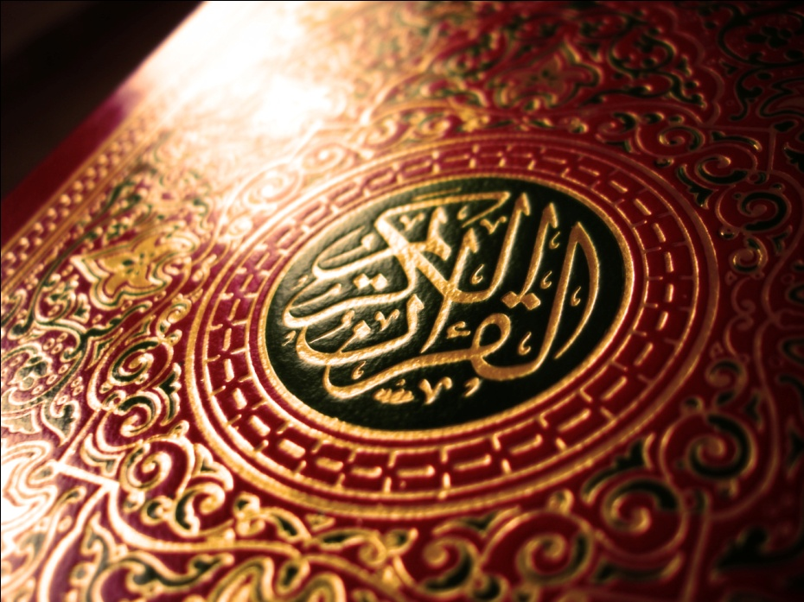
Second part of ayah…
Second part: ” Say, "Indeed, the [true] guidance is the guidance of Allah .”
This is called jumla-e-muhtariza, something that doesn’t have anything to do directly with the rest of ayah.

Slide 24
The rest of ayah…
Connected to first part.
Third part: Jewish scholars told their people that someone else cannot have what you’ve already gotten.
Fourth part: Do not tell them about your religion, they will argue with you about why you didn’t accept Islam.
Fifth part: What the prophet Muhammad SAW should say / respond.

Slide 25
Ayah 74
يَخْتَصُّ بِرَحْمَتِهِ مَن يَشَآءُ وَاللَّهُ ذُو الْفَضْلِ الْعَظِيمِ ﴾
He selects for His mercy whom He wills. And Allah is the possessor of great bounty.

Slide 26
Ayah 75
﴿وَمِنْ أَهْلِ الْكِتَـبِ مَنْ إِن تَأْمَنْهُ بِقِنْطَارٍ يُؤَدِّهِ إِلَيْكَ وَمِنْهُمْ مَّنْ إِن تَأْمَنْهُ بِدِينَارٍ لاَّ يُؤَدِّهِ إِلَيْكَ إِلاَّ مَا دُمْتَ عَلَيْهِ قَآئِمًا ذَلِكَ بِأَنَّهُمْ قَالُواْ لَيْسَ عَلَيْنَا فِى الأُمِّيِّينَ سَبِيلٌ وَيَقُولُونَ عَلَى اللَّهِ الْكَذِبَ وَهُمْ يَعْلَمُونَ -

Slide 27
Ayah 75 - Translation
And among the People of the Scripture is he who, if you entrust him with a great amount [of wealth], he will return it to you. And among them is he who, if you entrust him with a [single] silver coin, he will not return it to you unless you are constantly standing over him [demanding it]. That is because they say, "There is no blame upon us concerning the unlearned." And they speak untruth about Allah while they know [it].

Slide 28
Ayah 76
بَلَى مَنْ أَوْفَى بِعَهْدِهِ وَاتَّقَى فَإِنَّ اللَّهَ يُحِبُّ الْمُتَّقِينَ ﴾
But yes, whoever fulfills his commitment and fears Allah - then indeed, Allah loves those who fear Him.

Slide 29

The good and the bad…
There are some good traits in Ahl-e-Kitaab aswell.
Some are very good when it comes to giving other their rights, and fulfilling responsibilites.
While some have bad traits, and are not good at giving other their rights.
You cannot treat someone bad based on their faith / religion.

Slide 30
Ayah 77
﴿إِنَّ الَّذِينَ يَشْتَرُونَ بِعَهْدِ اللَّهِ وَأَيْمَـنِهِمْ ثَمَنًا قَلِيًلا أُوْلَـئِكَ لاَ خَلَـقَ لَهُمْ فِى الاٌّخِرَةِ وَلاَ يُكَلِّمُهُمُ اللَّهُ وَلاَ يَنظُرُ إِلَيْهِمْ يَوْمَ الْقِيَـمَةِ وَلاَ يُزَكِّيهِمْ وَلَهُمْ عَذَابٌ أَلِيمٌ ﴾

Slide 31
Ayah 77 - Translation
Indeed, those who exchange the covenant of Allah and their [own] oaths for a small price will have no share in the Hereafter, and Allah will not speak to them or look at them on the Day of Resurrection, nor will He purify them; and they will have a painful punishment.

Slide 32
To break covenants / oaths…
Five punishments for the one who breaks oaths.
1) ”will have no have no share in the Hereafter”,
2) ”Allah will not speak to them”
3 “or look at them on the Day of Resurrection”,
4) “nor will He purify them;”
5) “and they will have a painful punishment.”
One of the great sins (kabeerah gunnah) to break promises / oaths / covenants.

Slide 33

Activity for this lesson…

Slide 34
