Slide 1
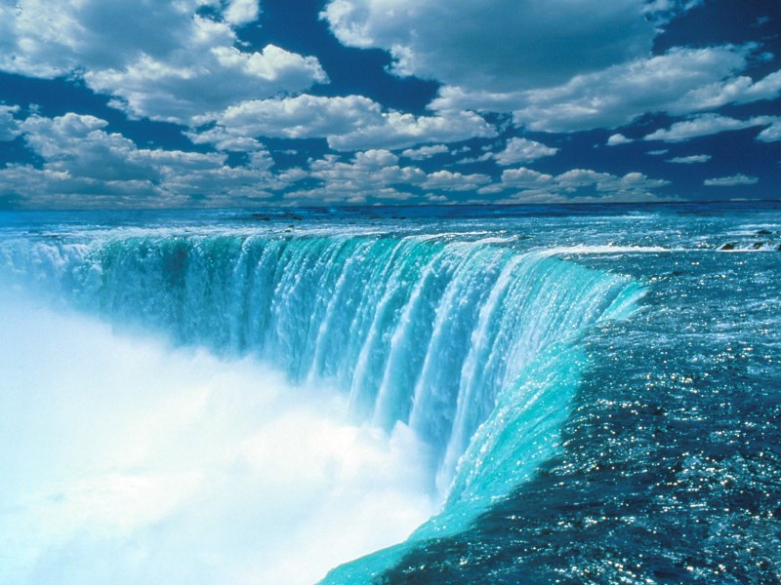
Sabeel ul Huda Lesson 44
Surah Al-e-Imran – 45-63

Slide 2
Topic of the verses:
The good tidings and a test for hz. Maryam [45-47]
The miracles and characteristics of hz. Isa AS [48-51]
The diciples of hz. Isa, and supporters for the cause of Allah [52-53]
Allah is the best planner [54]
The promises given by Allah SWT [55-57]
The truth about hz. Isa AS [58-60]
Those who argue after the knowledge has come [61-63]

Slide 3
Ayah 45
إِذْ قَالَتِ الْمَلَائِكَةُ يَا مَرْيَمُ إِنَّ اللَّـهَ يُبَشِّرُكِ بِكَلِمَةٍ مِّنْهُ اسْمُهُ الْمَسِيحُ عِيسَى ابْنُ مَرْيَمَ وَجِيهًا فِي الدُّنْيَا وَالْآخِرَةِ وَمِنَ الْمُقَرَّبِينَ ﴿٤٥﴾

Slide 4
Ayah 45 - Translation
[And mention] when the angels said, "O Mary, indeed Allah gives you good tidings of a word from Him, whose name will be the Messiah, Jesus, the son of Mary - distinguished in this world and the Hereafter and among those brought near [to Allah ].

Slide 5
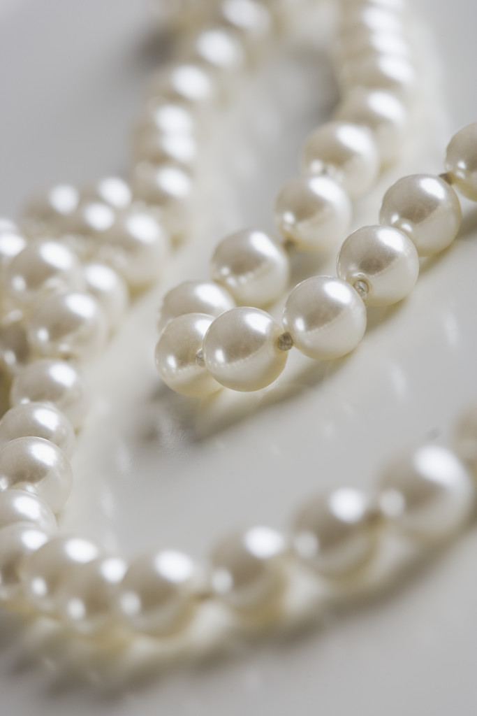
Hz. Maryam and hz. Isa AS…
Good tidings given to hz. Maryam, but also a test.
Why Messiah – Massih has 3 meanings: - the one who touches (touches the sick) - the blessed - never stayed at the same place.
Hz. Isa AS is the only prophet that is identified with the name of his mother, since he didn’t have a father.

Slide 6
Ayah 46
وَيُكَلِّمُ النَّاسَ فِي الْمَهْدِ وَكَهْلًا وَمِنَ الصَّالِحِينَ ﴿٤٦﴾ He will speak to the people in the cradle and in maturity and will be of the righteous."

Slide 7
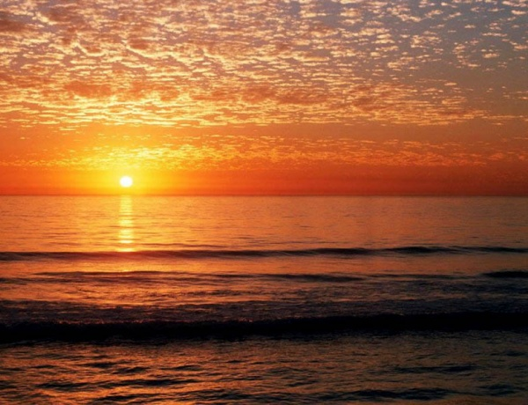
A sign…
This ayah is a sign of that hz. Isa AS will be back before the Day of Judgement.
Allah also likes to prepare the believers before a test or trial.

Slide 8
Ayah 47
قَالَتْ رَبِّ أَنَّىٰ يَكُونُ لِي وَلَدٌ وَلَمْ يَمْسَسْنِي بَشَرٌ ۖ قَالَ كَذَٰلِكِ اللَّـهُ يَخْلُقُ مَا يَشَاءُ ۚ إِذَا قَضَىٰ أَمْرًا فَإِنَّمَا يَقُولُ لَهُ كُن فَيَكُونُ ﴿٤٧﴾

Slide 9
Ayah 47 - Translation
She said, "My Lord, how will I have a child when no man has touched me?" [The angel] said, "Such is Allah ; He creates what He wills. When He decrees a matter, He only says to it, 'Be,' and it is.

Slide 10
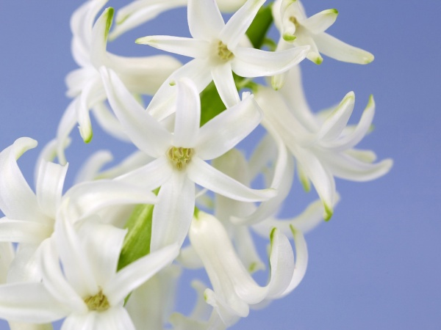
“He only says to it, 'Be,‘…”
Compare this ayah with the one about good news given to hz. Zakariya.
The difference between fayl and khalq. (Hz. Yahya and hz. Isa)
Allah does what He wants. He can make the impossible be possible.

Slide 11
Ayah 48
وَيُعَلِّمُهُ الْكِتَابَ وَالْحِكْمَةَ وَالتَّوْرَاةَ وَالْإِنجِيلَ ﴿٤٨﴾ And He will teach him writing and wisdom and the Torah and the Gospel

Slide 12
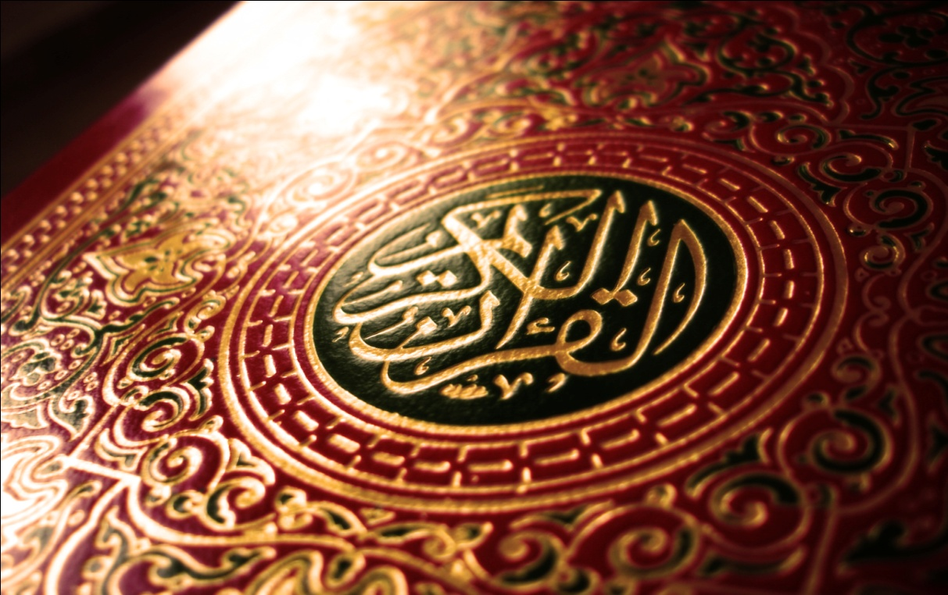
More about hz. Isa AS…
This ayah is a continuation of the ayah 46.
The charasteristics and qualities of hz. Isa.
Al-Kitab and Hikmah is the Quran and Hadith.

Slide 13
Ayah 49
وَرَسُولًا إِلَىٰ بَنِي إِسْرَائِيلَ أَنِّي قَدْ جِئْتُكُم بِآيَةٍ مِّن رَّبِّكُمْ ۖ أَنِّي أَخْلُقُ لَكُم مِّنَ الطِّينِ كَهَيْئَةِ الطَّيْرِ فَأَنفُخُ فِيهِ فَيَكُونُ طَيْرًا بِإِذْنِ اللَّـهِ ۖ وَأُبْرِئُ الْأَكْمَهَ وَالْأَبْرَصَ وَأُحْيِي الْمَوْتَىٰ بِإِذْنِ اللَّـهِ ۖ وَأُنَبِّئُكُم بِمَا تَأْكُلُونَ وَمَا تَدَّخِرُونَ فِي بُيُوتِكُمْ ۚ إِنَّ فِي ذَٰلِكَ لَآيَةً لَّكُمْ إِن كُنتُم مُّؤْمِنِينَ ﴿٤٩﴾

Slide 14
Ayah 49 - Translation
And [make him] a messenger to the Children of Israel, [who will say], 'Indeed I have come to you with a sign from your Lord in that I design for you from clay [that which is] like the form of a bird, then I breathe into it and it becomes a bird by permission of Allah . And I cure the blind and the leper, and I give life to the dead - by permission of Allah . And I inform you of what you eat and what you store in your houses. Indeed in that is a sign for you, if you are believers.

Slide 15
The miracles of hz. Isa AS…
Hz. Isa was not sent as a messenger for everyone, but specifically for Bani Israil.
Prophet Muhammad SAW was sent for the whole of mankind and humanity.
Hz. Isa performed miracles, by the permission of Allah: 1) breathe life into a bird 2) cure the blind 3) cure the leper (skin disease) 4) give life to the dead 5) inform what they had eaten 6) inform what they had stored in their houses.

Slide 16
Ayah 50
وَمُصَدِّقًا لِّمَا بَيْنَ يَدَيَّ مِنَ التَّوْرَاةِ وَلِأُحِلَّ لَكُم بَعْضَ الَّذِي حُرِّمَ عَلَيْكُمْ ۚ وَجِئْتُكُم بِآيَةٍ مِّن رَّبِّكُمْ فَاتَّقُوا اللَّـهَ وَأَطِيعُونِ ﴿٥٠﴾

Slide 17
Ayah 50 - Translation
And [I have come] confirming what was before me of the Torah and to make lawful for you some of what was forbidden to you. And I have come to you with a sign from your Lord, so fear Allah and obey me.

Slide 18

“Make lawful what was forbidden…”
More about the signs and characteristics of hz. Isa.
Some of the jewish scholars made the religion very difficult to practice, by making the lawful forbidden.
The same thing has happend to Islam, people have made it difficult.

Slide 19
Ayah 51
إِنَّ اللَّـهَ رَبِّي وَرَبُّكُمْ فَاعْبُدُوهُ ۗ هَـٰذَا صِرَاطٌ مُّسْتَقِيمٌ ﴿٥١﴾ Indeed, Allah is my Lord and your Lord, so worship Him. That is the straight path."

Slide 20

Hz. Isa is a prophet…
This ayah clearly shows that the belief in Christianity about trinity etc. is wrong.
Islam says that hz. Isa is not God / God’s son, but a mighty messenger and prophet.

Slide 21
Ayah 52
﴿فَلَمَّآ أَحَسَّ عِيسَى مِنْهُمُ الْكُفْرَ قَالَ مَنْ أَنصَارِى إِلَى اللَّهِ قَالَ الْحَوَارِيُّونَ نَحْنُ أَنْصَارُ اللَّهِ ءَامَنَّا بِاللَّهِ وَاشْهَدْ بِأَنَّا مُسْلِمُونَ -

Slide 22
Ayah 52 - Translation
But when Jesus felt [persistence in] disbelief from them, he said, "Who are my supporters for [the cause of] Allah ?" The disciples said," We are supporters for Allah . We have believed in Allah and testify that we are Muslims [submitting to Him].

Slide 23
More about ayah 53
The leader of that time was plotting against hz. Isa.
Hz. Isa could feel that the people were denying and rejecting the truth.
Hawaari of hz. Isa AS, was just as the Sahaabi of prophet Muhammad SAW.
Ansar-Allah, the first thing is to believe in Allah.
They don’t belong to a specific group, call themselves only Muslims.

Slide 24
Ayah 53
رَبَّنَا آمَنَّا بِمَا أَنزَلْتَ وَاتَّبَعْنَا الرَّسُولَ فَاكْتُبْنَا مَعَ الشَّاهِدِينَ ﴿٥٣﴾
Our Lord, we have believed in what You revealed and have followed the messenger Jesus, so register us among the witnesses [to truth]."

Slide 25
Ayah 54
وَمَكَرُوا وَمَكَرَ اللَّـهُ ۖ وَاللَّـهُ خَيْرُ الْمَاكِرِينَ ﴿٥٤﴾
And the disbelievers planned, but Allah planned. And Allah is the best of planners.

Slide 26
Ayah 55
إِذْ قَالَ اللَّـهُ يَا عِيسَىٰ إِنِّي مُتَوَفِّيكَ وَرَافِعُكَ إِلَيَّ وَمُطَهِّرُكَ مِنَ الَّذِينَ كَفَرُوا وَجَاعِلُ الَّذِينَ اتَّبَعُوكَ فَوْقَ الَّذِينَ كَفَرُوا إِلَىٰ يَوْمِ الْقِيَامَةِ ۖ ثُمَّ إِلَيَّ مَرْجِعُكُمْ فَأَحْكُمُ بَيْنَكُمْ فِيمَا كُنتُمْ فِيهِ تَخْتَلِفُونَ ﴿٥٥﴾

Slide 27
Ayah 55 - Translation
[Mention] when Allah said, "O Jesus, indeed I will take you and raise you to Myself and purify you from those who disbelieve and make those who follow you [in submission to Allah alone] superior to those who disbelieve until the Day of Resurrection. Then to Me is your return, and I will judge between you concerning that in which you used to differ.

Slide 28
Ayah 55 Background....
No Rasool Died by the hands of enemies…
whenever ppl tried to kil the Prophet ,he migrated to some other city , but issa,s migration was towards sky instead of going to some other land..
‘’ Garden of Death Ceremony ‘’

Slide 29

More about ayah 55
”Mutawaffiika”: meaning, different meanings.. L ike
Give up , Give in,
Put on , put off etc.
hz. Isa AS did not die, he was taken up to the heavens, with his body and soul.
Allah swt is giving glad tidings not sad news....
The Christians will always be superior to Jews.
The Hadith is a ”dictionary” for the Quran, where we can find the correct meaning of the words in the Quran.

Slide 30

Promises by Allah…
Five promises were given to hz. Isa AS by Allah: 1) Not be killed by jews, but die at the appointed time. 2) Was taken up to the heavens. 3) Purify you from what the disbelievers say. 4) Those who follow you will be superior to those who disbelieve. 5) Judge between you in what you differ.

Slide 31
Ayah 56
فَأَمَّا الَّذِينَ كَفَرُوا فَأُعَذِّبُهُمْ عَذَابًا شَدِيدًا فِي الدُّنْيَا وَالْآخِرَةِ وَمَا لَهُم مِّن نَّاصِرِينَ ﴿٥٦﴾ And as for those who disbelieved, I will punish them with a severe punishment in this world and the Hereafter, and they will have no helpers."

Slide 32
Ayah 57
وَأَمَّا الَّذِينَ آمَنُوا وَعَمِلُوا الصَّالِحَاتِ فَيُوَفِّيهِمْ أُجُورَهُمْ ۗ وَاللَّـهُ لَا يُحِبُّ الظَّالِمِينَ ﴿٥٧﴾ But as for those who believed and did righteous deeds, He will give them in full their rewards, and Allah does not like the wrongdoers.

Slide 33
Ayah 58
ذَٰلِكَ نَتْلُوهُ عَلَيْكَ مِنَ الْآيَاتِ وَالذِّكْرِ الْحَكِيمِ ﴿٥٨﴾ This is what We recite to you, [O Muhammad], of [Our] verses and the precise [and wise] message.

Slide 34
Ayah 59
إِنَّ مَثَلَ عِيسَىٰ عِندَ اللَّـهِ كَمَثَلِ آدَمَ ۖ خَلَقَهُ مِن تُرَابٍ ثُمَّ قَالَ لَهُ كُن فَيَكُونُ ﴿٥٩﴾ Indeed, the example of Jesus to Allah is like that of Adam. He created Him from dust; then He said to him, "Be," and he was.

Slide 35

Hz. Adam and hz. Isa…
Hz. Adam didn’t have any mother or father, so why is hz. Isa considered a god?
Both Adam and Isa were humans and prophets.

Slide 36
Ayah 60
الْحَقُّ مِن رَّبِّكَ فَلَا تَكُن مِّنَ الْمُمْتَرِينَ ﴿٦٠﴾
The truth is from your Lord, so do not be among the doubters.

Slide 37
Ayah 61
فَمَنْ حَاجَّكَ فِيهِ مِن بَعْدِ مَا جَاءَكَ مِنَ الْعِلْمِ فَقُلْ تَعَالَوْا نَدْعُ أَبْنَاءَنَا وَأَبْنَاءَكُمْ وَنِسَاءَنَا وَنِسَاءَكُمْ وَأَنفُسَنَا وَأَنفُسَكُمْ ثُمَّ نَبْتَهِلْ فَنَجْعَل لَّعْنَتَ اللَّـهِ عَلَى الْكَاذِبِينَ ﴿٦١﴾

Slide 38
Ayah 61 - Translation
Then whoever argues with you about it after [this] knowledge has come to you - say, "Come, let us call our sons and your sons, our women and your women, ourselves and yourselves, then supplicate earnestly [together] and invoke the curse of Allah upon the liars [among us]."

Slide 39
Ayah 62
إِنَّ هَـٰذَا لَهُوَ الْقَصَصُ الْحَقُّ ۚ وَمَا مِنْ إِلَـٰهٍ إِلَّا اللَّـهُ ۚ وَإِنَّ اللَّـهَ لَهُوَ الْعَزِيزُ الْحَكِيمُ ﴿٦٢﴾ Indeed, this is the true narration. And there is no deity except Allah . And indeed, Allah is the Exalted in Might, the Wise.

Slide 40
Ayah 63
فَإِن تَوَلَّوْا فَإِنَّ اللَّـهَ عَلِيمٌ بِالْمُفْسِدِينَ ﴿٦٣﴾ But if they turn away, then indeed - Allah is Knowing of the corrupters.

Slide 41
More about ayah 61-63
Ayah 61-63 are connected to a specific incident that took place.
Ayah 61 is called the ayat-e-mubahilah.
The incident took place after Fatha-e-Makkah, when the Jews of Najran were invited to accept Islam.

Slide 42
Activity for this lesson…

Slide 43
