Slide 1

Sabeel ul Huda
Lesson 43
Surah Al-e-Imran – 33-44

Slide 2
Topic of the verses
The chosen prophets [33-34]
The pledge of the wife of Imran [35]
The story of Maryam AS [36-37]
Supplication of prophet Zakariya [38]
Good tidings about prophet Yahya [39]
The response of prophet Zakariya [40-41]
Maryam AS, chosen by Allah [42-43]
The prophet Muhammad SAW was not there when this happened [44]

Slide 3
Ayah 33
﴿إِنَّ اللَّهَ اصْطَفَى آدَمَ وَنُوحًا وَءَالَ إِبْرَهِيمَ وَءَالَ عِمْرَنَ عَلَى الْعَـلَمِينَ –
Indeed, Allah chose Adam and Noah and the family of Abraham and the family of 'Imran over the worlds -

Slide 4
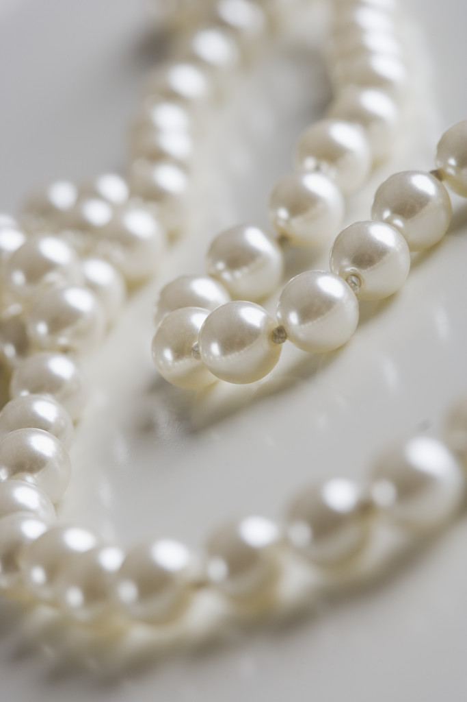
The chosen prophets…
This is connected to the last ayah, about following the prophet Muhammad SAW.
Those who deny his prophethood, are told that he is part of a chain of prophets which has been going on from the beginning.

Slide 5
The chosen prophets…
This ayah is also an answer to those who claim that Jesus is the son of God. What about Prophet Adam then? He was born without a mother and father. A miracle.
Prophet Noah was alive for 1000 years, another miracle.
Prophet Ibrahim, all prophets were chosen from his family.
Just like them, Prophet Muhammad SAW has been chosen.

Slide 6
Ayah 34
ذُرِّيَّةً بَعْضُهَا مِن بَعْضٍ وَاللَّهُ سَمِيعٌ عَلِيمٌ
Descendants, some of them from others. And Allah is Hearing and Knowing.

Slide 7

”Descendants…”
This ayah is also an answer to those who claim that Jesus is God/son of God.
Humans only give birth to humans, not gods.

Slide 8
Ayah 35
إِذْ قَالَتِ امْرَأَتُ عِمْرَانَ رَبِّ إِنِّي نَذَرْتُ لَكَ مَا فِي بَطْنِي مُحَرَّرًا فَتَقَبَّلْ مِنِّي ۖ إِنَّكَ أَنتَ السَّمِيعُ الْعَلِيمُ ﴿٣٥﴾
[Mention, O Muhammad], when the wife of 'Imran said, "My Lord, indeed I have pledged to You what is in my womb, consecrated [for Your service], so accept this from me. Indeed, You are the Hearing, the Knowing."

Slide 9
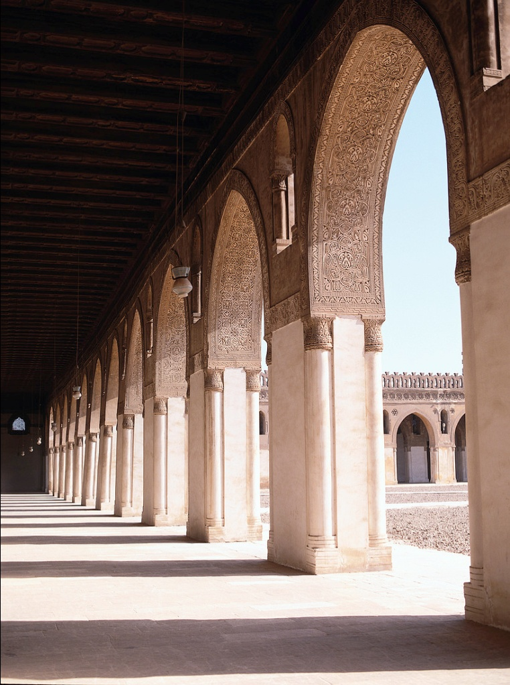
“consecrated [for Your service]…”
About the pledge that the mother of Maryam made.
At that time it was common to devote the children for the worship of God.
The example of the mother of Imam Bukhari.

Slide 10
Ayah 36
فَلَمَّا وَضَعَتْهَا قَالَتْ رَبِّ إِنِّي وَضَعْتُهَا أُنثَىٰ وَاللَّـهُ أَعْلَمُ بِمَا وَضَعَتْ وَلَيْسَ الذَّكَرُ كَالْأُنثَىٰ ۖ وَإِنِّي سَمَّيْتُهَا مَرْيَمَ وَإِنِّي أُعِيذُهَا بِكَ وَذُرِّيَّتَهَا مِنَ الشَّيْطَانِ الرَّجِيمِ ﴿٣٦﴾

Slide 11
Ayah 36 - Translation
But when she delivered her, she said, "My Lord, I have delivered a female." And Allah was most knowing of what she delivered, "And the male is not like the female. And I have named her Mary, and I seek refuge for her in You and [for] her descendants from Satan, the expelled [from the mercy of Allah ]."

Slide 12
More about ayah 36…
At that time it was not allowed / not common that girls could devote themselves to worship like this.
They were not allowed to enter Bait-ul-Muqaddas.
Good mothers are essential and important for raising good children.
The grandmother also prayed for the protection of Prophet Isa.
Monasticism not allowed in Islam, as the Christians to it.

Slide 13
Ayah 37
فَتَقَبَّلَهَا رَبُّهَا بِقَبُولٍ حَسَنٍ وَأَنبَتَهَا نَبَاتًا حَسَنًا وَكَفَّلَهَا زَكَرِيَّا ۖ كُلَّمَا دَخَلَ عَلَيْهَا زَكَرِيَّا الْمِحْرَابَ وَجَدَ عِندَهَا رِزْقًا ۖ قَالَ يَا مَرْيَمُ أَنَّىٰ لَكِ هَـٰذَا ۖ قَالَتْ هُوَ مِنْ عِندِ اللَّـهِ ۖ إِنَّ اللَّـهَ يَرْزُقُ مَن يَشَاءُ بِغَيْرِ حِسَابٍ ﴿٣٧﴾

Slide 14
Ayah 37 - Translation
So her Lord accepted her with good acceptance and caused her to grow in a good manner and put her in the care of Zechariah. Every time Zechariah entered upon her in the prayer chamber, he found with her provision. He said, "O Mary, from where is this [coming] to you?" She said, "It is from Allah . Indeed, Allah provides for whom He wills without account."

Slide 15
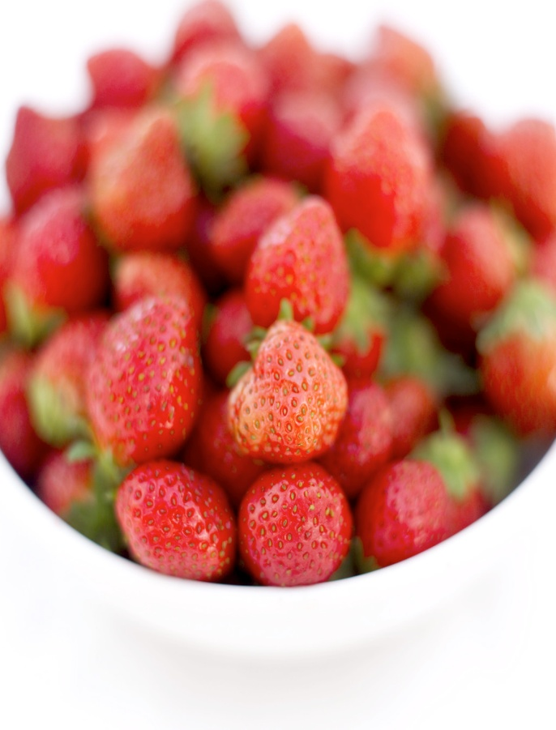
More about ayah 37
”So her Lord accepted her with good acceptance”: this was such a big honor for the mother of Maryam, that her pledge was accepted.
” in the care of Zechariah.” : Maryam was being taken care of by her uncle, prophet Zakariya.
She spent her youth in worship.
“provisions” are meant delicious fruits or knowledge in this context.

Slide 16
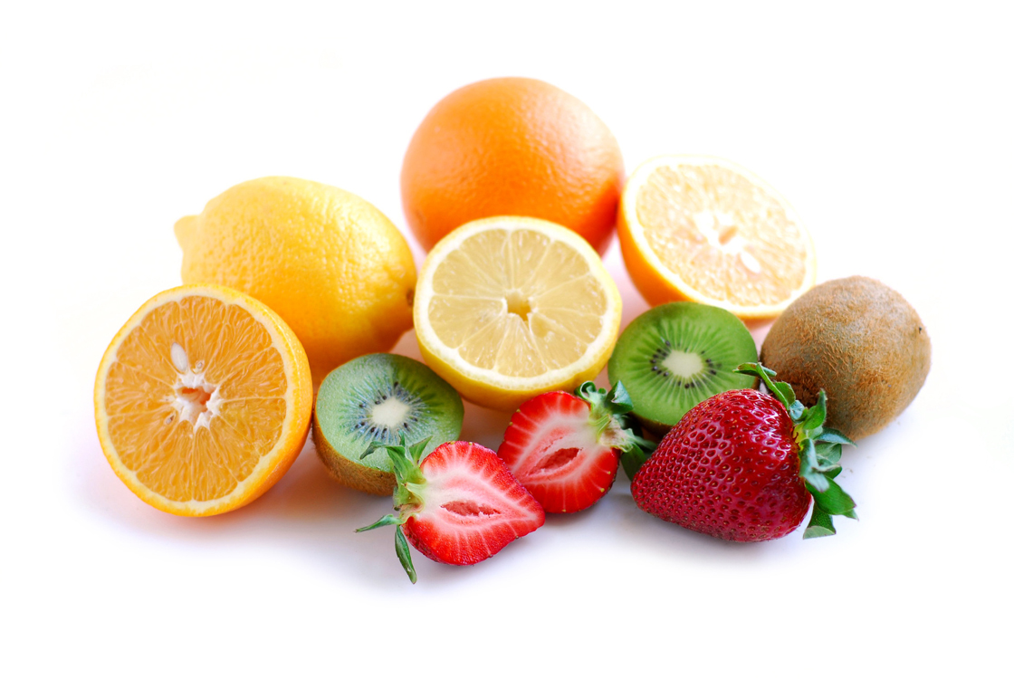
Rizq…
It is not allowed to disobey or do something which will make Allah angry, for the sake of rizq.
Jinns and humans are created for worship (ibadat), it is Allah who gives rizq.

Slide 17
Ayah 38
هُنَالِكَ دَعَا زَكَرِيَّا رَبَّهُ ۖ قَالَ رَبِّ هَبْ لِي مِن لَّدُنكَ ذُرِّيَّةً طَيِّبَةً ۖ إِنَّكَ سَمِيعُ الدُّعَاءِ ﴿٣٨﴾
At that, Zechariah called upon his Lord, saying, "My Lord, grant me from Yourself a good offspring. Indeed, You are the Hearer of supplication."

Slide 18
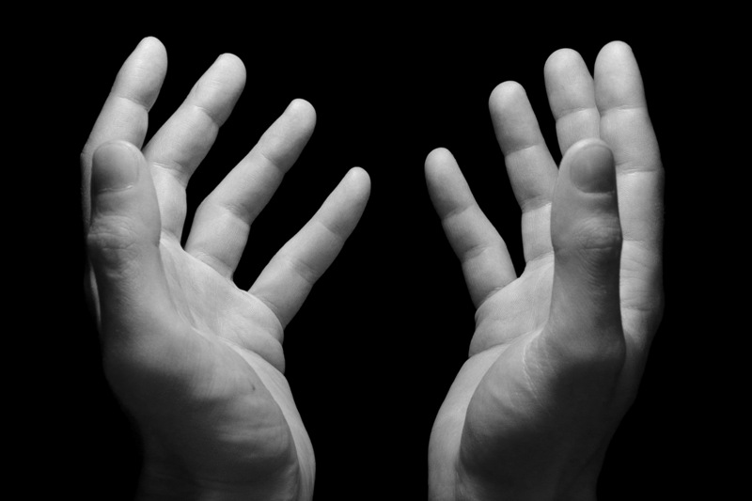
”Zechariah called upon his Lord…”
When prophet Zakariya saw that Maryam was being blessed by Allah with these fruits, he felt encouraged to supplicate for a good child.

Slide 19
Ayah 39
فَنَادَتْهُ الْمَلَائِكَةُ وَهُوَ قَائِمٌ يُصَلِّي فِي الْمِحْرَابِ أَنَّ اللَّـهَ يُبَشِّرُكَ بِيَحْيَىٰ مُصَدِّقًا بِكَلِمَةٍ مِّنَ اللَّـهِ وَسَيِّدًا وَحَصُورًا وَنَبِيًّا مِّنَ الصَّالِحِينَ ﴿٣٩﴾

Slide 20
Ayah 39 - Translation
So the angels called him while he was standing in prayer in the chamber, "Indeed, Allah gives you good tidings of John, confirming a word from Allah and [who will be] honorable, abstaining [from women], and a prophet from among the righteous."

Slide 21

Prophet Yahya (John)…
Prophet Yahya’s name was decided and given by Allah SWT Himself.
Yahya means someone who will stay alive.
He will be confirming the word of Allah, in this context ”the word of Allah” is meant Prophet Isa.
He was also a chosen prophet, amongst the sualiheen.

Slide 22
Ayah 40
قَالَ رَبِّ أَنَّىٰ يَكُونُ لِي غُلَامٌ وَقَدْ بَلَغَنِيَ الْكِبَرُ وَامْرَأَتِي عَاقِرٌ ۖ قَالَ كَذَٰلِكَ اللَّـهُ يَفْعَلُ مَا يَشَاءُ ﴿٤٠﴾
He said, "My Lord, how will I have a boy when I have reached old age and my wife is barren?" The angel said, "Such is Allah ; He does what He wills."

Slide 23
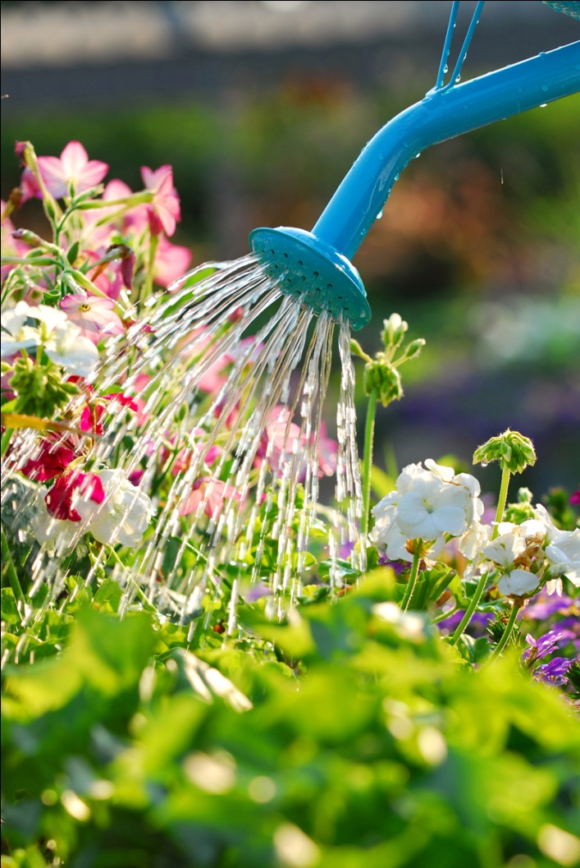
More about ayah 40…
The word ”ghulam” is used for a boy before his teenage.
It was not that prophet Zakariya didn’t have faith in Allah, it was just that he was shocked and wondered how it would happen.

Slide 24
Ayah 41
قَالَ رَبِّ اجْعَل لِّي آيَةً ۖ قَالَ آيَتُكَ أَلَّا تُكَلِّمَ النَّاسَ ثَلَاثَةَ أَيَّامٍ إِلَّا رَمْزًا ۗ وَاذْكُر رَّبَّكَ كَثِيرًا وَسَبِّحْ بِالْعَشِيِّ وَالْإِبْكَارِ ﴿٤١﴾

Slide 25
Ayah 41 - Translation
He said, "My Lord, make for me a sign." He Said, "Your sign is that you will not [be able to] speak to the people for three days except by gesture. And remember your Lord much and exalt [Him with praise] in the evening and the morning."

Slide 26
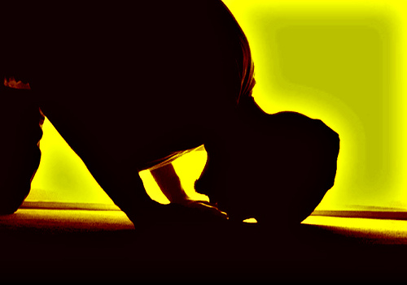
”make for me a sign…”
He wanted a sign so he could be grateful to Allah.
As a sign, he was not allowed to talk to anyone for three days.
This is also a reminder, to be conscious about how we display our happiness. Do you do it in a way that pleases Allah?

Slide 27
Ayah 42
وَإِذْ قَالَتِ الْمَلَائِكَةُ يَا مَرْيَمُ إِنَّ اللَّـهَ اصْطَفَاكِ وَطَهَّرَكِ وَاصْطَفَاكِ عَلَىٰ نِسَاءِ الْعَالَمِينَ ﴿٤٢﴾
And [mention] when the angels said, "O Mary, indeed Allah has chosen you and purified you and chosen you above the women of the worlds.

Slide 28
Ayah 43
يَا مَرْيَمُ اقْنُتِي لِرَبِّكِ وَاسْجُدِي وَارْكَعِي مَعَ الرَّاكِعِينَ ﴿٤٣﴾
O Mary, be devoutly obedient to your Lord and prostrate and bow with those who bow [in prayer]."

Slide 29
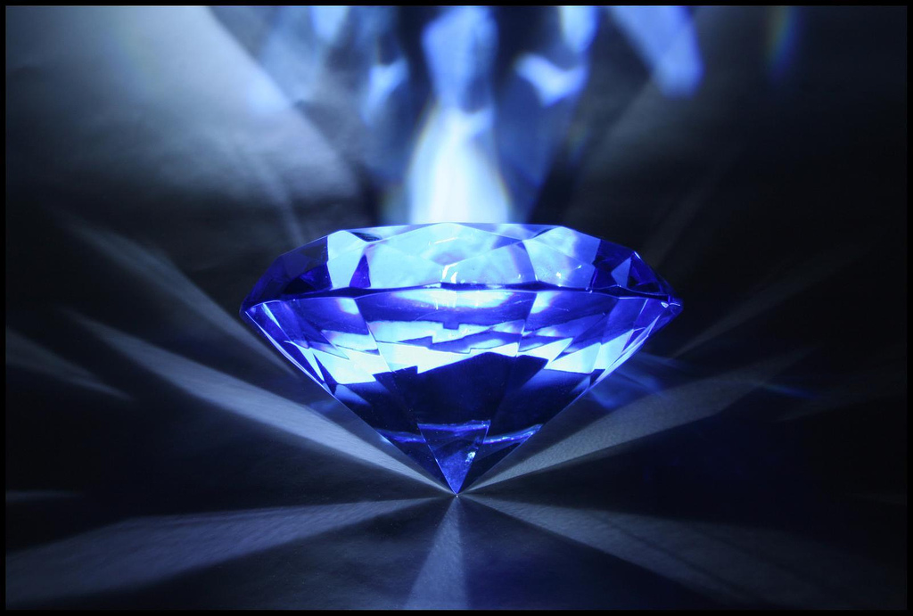
”Allah has chosen you…”
What to do when chosen by Allah:
be obedient, consistent,
humble, prostrate
and bow down to Allah SWT.

Slide 30
Ayah 44
ذَٰلِكَ مِنْ أَنبَاءِ الْغَيْبِ نُوحِيهِ إِلَيْكَ ۚ وَمَا كُنتَ لَدَيْهِمْ إِذْ يُلْقُونَ أَقْلَامَهُمْ أَيُّهُمْ يَكْفُلُ مَرْيَمَ وَمَا كُنتَ لَدَيْهِمْ إِذْ يَخْتَصِمُونَ ﴿٤٤﴾

Slide 31
Ayah 44 - Translation
That is from the news of the unseen which We reveal to you, [O Muhammad]. And you were not with them when they cast their pens as to which of them should be responsible for Mary. Nor were you with them when they disputed.

Slide 32
Activity for this lesson…

Slide 33
