Slide 1


Sabeel ul Huda Lesson 41
Duniya Zaroorat hy Maqsad nahi
Surah Al-e-Imran – 14-22

Slide 2

Topic of the verses:
The Islamic concept about love of things of this world [14]
Taqwa (fear of Allah) is the condition for entering Jannah [15]
What do the muttaqin say [16]
The attributes of those who will go to Jannah [17]
Ayat-e-Shahaadat [18]
The only acceptable deen in the sight of Allah is Islam / The difference of opinion between those with knowledge [19]
What to reply when they argue with you [20]
What do the disbelievers do [21]
When do good deeds become worthless [22]

Slide 3
Ayah 14
زُيِّنَ لِلنَّاسِ حُبُّ الشَّهَوَاتِ مِنَ النِّسَاءِ وَالْبَنِينَ وَالْقَنَاطِيرِ الْمُقَنطَرَةِ مِنَ الذَّهَبِ وَالْفِضَّةِ وَالْخَيْلِ الْمُسَوَّمَةِ وَالْأَنْعَامِ وَالْحَرْثِ ۗ ذَٰلِكَ مَتَاعُ الْحَيَاةِ الدُّنْيَا ۖ وَاللَّـهُ عِندَهُ حُسْنُ الْمَآبِ ﴿١٤﴾

Slide 4
Ayah 14 - Translation
Beautified for people is the love of that which they desire - of women and sons, heaped-up sums of gold and silver, fine branded horses, and cattle and tilled land. That is the enjoyment of worldly life, but Allah has with Him the best return.

Slide 5

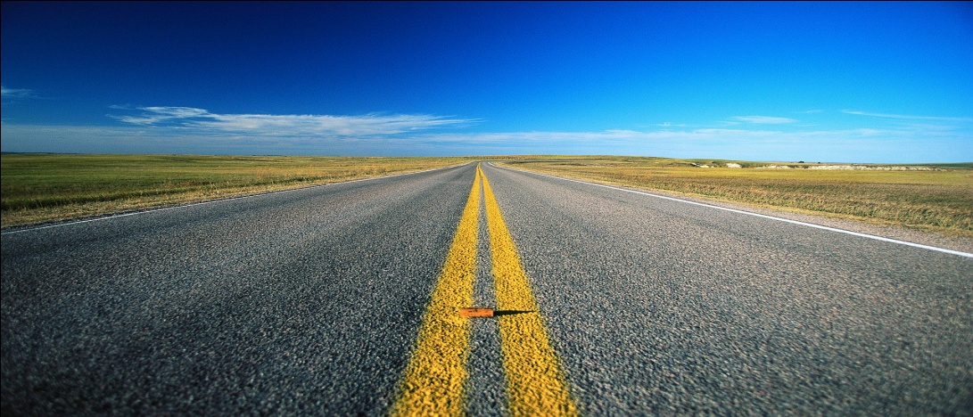
The Islamic concept…
connected to the previous ayah, what is it that stops you from spending and sacrificing in the way of Allah.
This ayah shows the true Islamic concept of worldly things.
Islam gave a middle way between two extremes. .

Slide 6

”Beautified for people is the love…”
”for people”: meaning also the believers, they also love these things. But when the imaan doesn’t limit this love, it goes extreme.
Two kinds of beauty (zeenat): 1) Outer beauty (materialistic) 2) Inner beauty

Slide 7

”of women and sons…”
The love of women, this is a natural feeling, but there is a difference between what you have and what you don’t have and desire it.
Hadith: “This life is a delight, and the best of its delight is a righteous wife”
Do not make this love a fitna.
The love of sons, a natural feeling of getting weaker day by day, and we want someone to take care of us, and inherit what we have made.

Slide 8
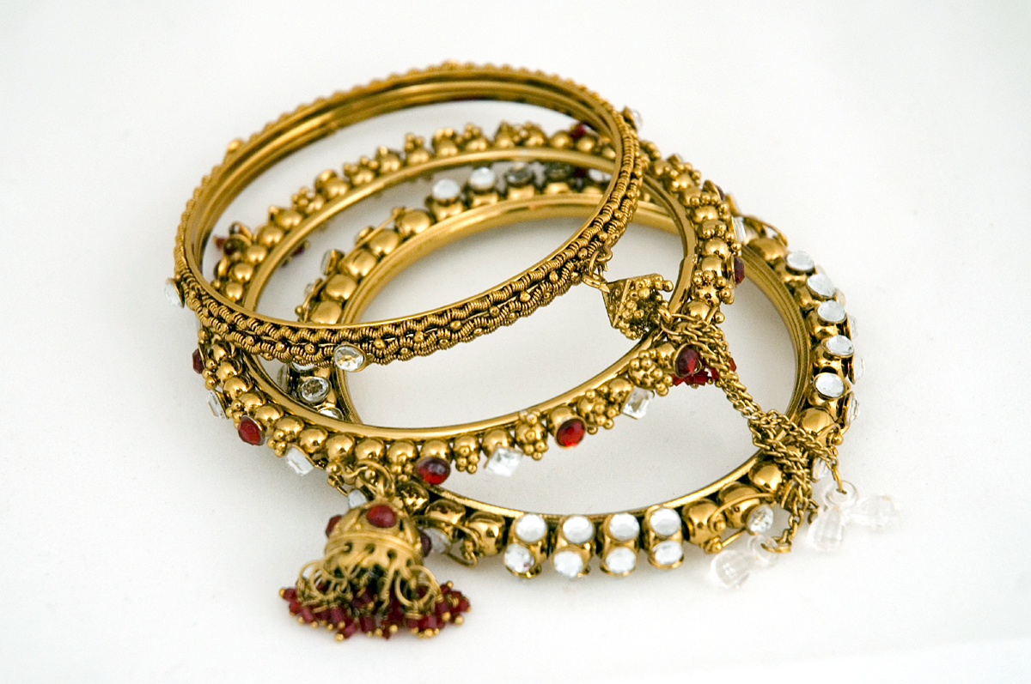
” gold and silver, fine branded horses…”
The love of gold and silver is allowed, but must not be something that is given more importance than deen.
Horse, can be compared to branded cars in this time. If something is used for necessity, there is no ajar or gunnah, but you will be held accountable for it.

Slide 9
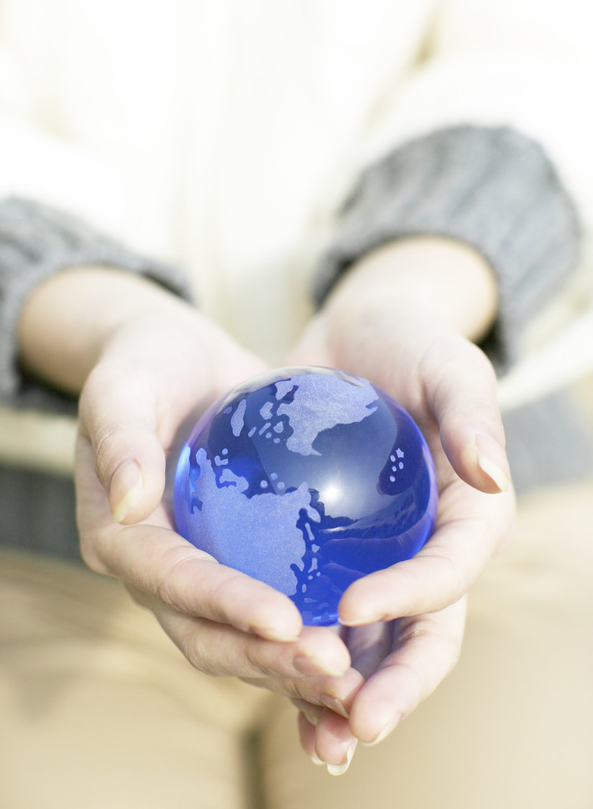
Why Allah swt put this Love ?
1) To make the order of this world going 2) To get a taste of the blessings of Jannah 3) As a test / trial
4) To give us reward of leaving thses things for Allah swt.
The love of duniya is a natural thing, but when you exaggarate and cross limits it is wrong.

Slide 10
Balance is the key…
The things of this world have to be used for necessity, but do not let them take over your heart.
Avoiding and not using the things of this world is not a part of Islam as well. There has to be a balance.
Example of Ship & water..

Slide 11
Ayah 15
قُلْ أَؤُنَبِّئُكُم بِخَيْرٍ مِّن ذَٰلِكُمْ ۚ لِلَّذِينَ اتَّقَوْا عِندَ رَبِّهِمْ جَنَّاتٌ تَجْرِي مِن تَحْتِهَا الْأَنْهَارُ خَالِدِينَ فِيهَا وَأَزْوَاجٌ مُّطَهَّرَةٌ وَرِضْوَانٌ مِّنَ اللَّـهِ ۗ وَاللَّـهُ بَصِيرٌ بِالْعِبَادِ ﴿١٥﴾

Slide 12
Ayah 15 - Translation
Say, "Shall I inform you of [something] better than that? For those who fear Allah will be gardens in the presence of their Lord beneath which rivers flow, wherein they abide eternally, and purified spouses and approval from Allah . And Allah is Seeing of [His] servants -

Slide 13

”For those who fear Allah…”
This ayah tells about something that is even better than the things of this world.
But this is only for those who fear Allah, while the things of this world is for everyone.

Slide 14
Ayah 16 – Translation
الَّذِينَ يَقُولُونَ رَبَّنَا إِنَّنَا آمَنَّا فَاغْفِرْ لَنَا ذُنُوبَنَا وَقِنَا عَذَابَ النَّارِ ﴿١٦﴾
Those who say, "Our Lord, indeed we have believed, so forgive us our sins and protect us from the punishment of the Fire,"

Slide 15
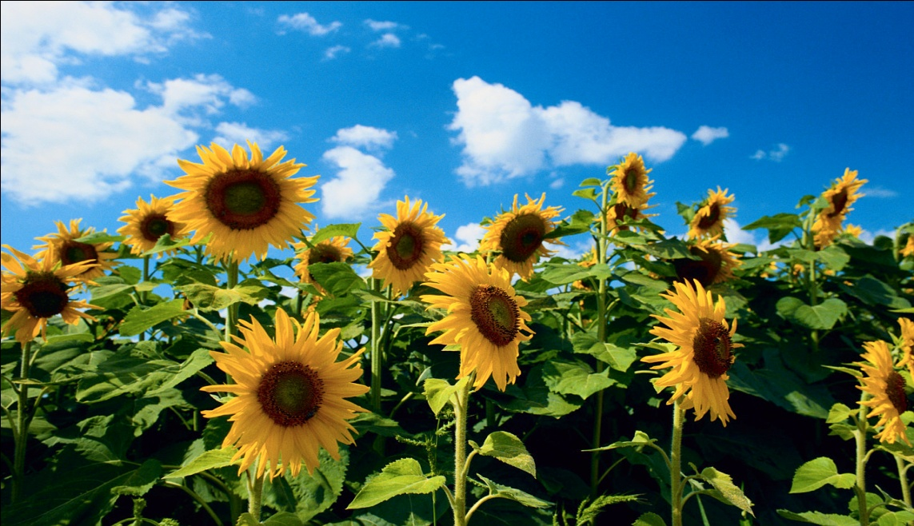
What those with taqwa say…
This ayah contains 3 things: 1) Confirming the belief 2) Forgiveness of the sins 3) Praying for protection from the Fire

Slide 16
Ayah 17 - Translation
الصَّابِرِينَ وَالصَّادِقِينَ وَالْقَانِتِينَ وَالْمُنفِقِينَ وَالْمُسْتَغْفِرِينَ بِالْأَسْحَارِ ﴿١٧﴾
The patient, the true, the obedient, those who spend [in the way of Allah ], and those who seek forgiveness before dawn.

Slide 17

Assabreen…?
Content for Duniya
&
Embisious for Akhirah

Slide 18
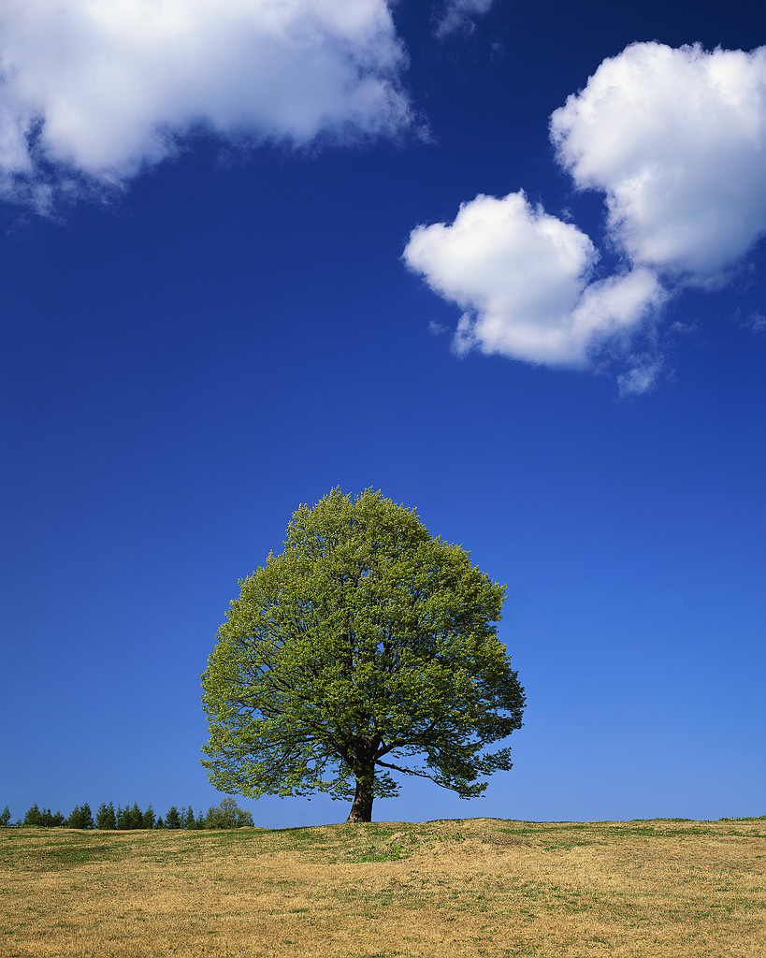
Assabreen to mustugfireen......
These are the conditions that have to be fulfilled to get to Jannah.
This world is a miniature of the aakhirah, a taste of what is yet to come.

Slide 19
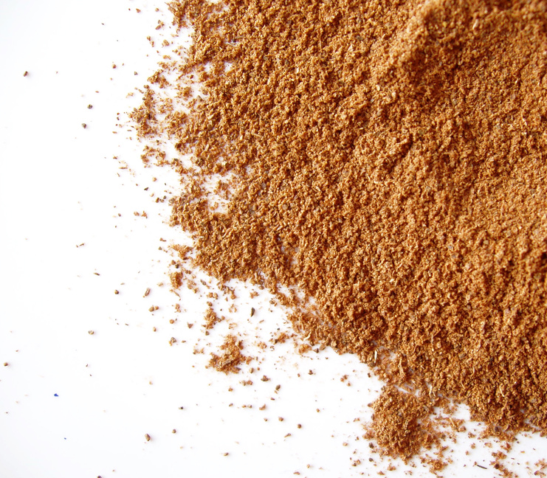
Meeting with Allah....
A hadith about the conversation between Allah and the people of Jannah. ...

Slide 20
Ayah 18 - Translation
شَهِدَ اللَّـهُ أَنَّهُ لَا إِلَـٰهَ إِلَّا هُوَ وَالْمَلَائِكَةُ وَأُولُو الْعِلْمِ قَائِمًا بِالْقِسْطِ ۚ لَا إِلَـٰهَ إِلَّا هُوَ الْعَزِيزُ الْحَكِيمُ ﴿١٨﴾
Allah witnesses that there is no deity except Him, and [so do] the angels and those of knowledge - [that He is] maintaining [creation] in justice. There is no deity except Him, the Exalted in Might, the Wise.

Slide 21

Ayat-e-Shahaadat…
This ayah is called Ayat-e-Shahaadat, and is one of the strongest ayah of Surah Al-e-Imran.
Read after Farz Slat..
Allah witnesses His tawheed.
So does the angels, and the people with knowledge.
Everything in the universe is witness to that Allah created them.

Slide 22
Ayah 19
إِنَّ الدِّينَ عِندَ اللَّـهِ الْإِسْلَامُ ۗ وَمَا اخْتَلَفَ الَّذِينَ أُوتُوا الْكِتَابَ إِلَّا مِن بَعْدِ مَا جَاءَهُمُ الْعِلْمُ بَغْيًا بَيْنَهُمْ ۗ وَمَن يَكْفُرْ بِآيَاتِ اللَّـهِ فَإِنَّ اللَّـهَ سَرِيعُ الْحِسَابِ ﴿١٩﴾

Slide 23
Ayah 19 - Translation
Indeed, the religion in the sight of Allah is Islam. And those who were given the Scripture did not differ except after knowledge had come to them - out of jealous animosity between themselves. And whoever disbelieves in the verses of Allah , then indeed, Allah is swift in [taking] account.

Slide 24
Meanings of word Deen.?
Tareeqa….
Religion….
Way of Life ….Life styl
Law…Qanoon
System of obidience.

Slide 25
Meanings of word ‘’ Islam’’
To submit ,
To Srunnder
Jhuka dyna.
Islam is peace…..why are muslim called as Terrorist ?
Every prophet ,s religion was islam
All the creations are muslim
Al-islam = Religion of Prophet Mohammad Saaw.

Slide 26
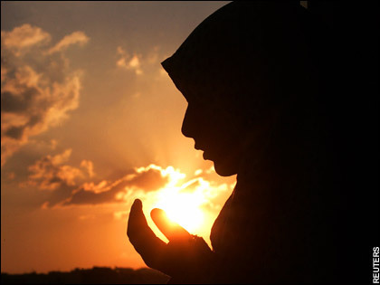
Islam is the only true religion…
This is one ayah that solves many problems.
Islam is the only right and acceptable religion in the sight of Allah.
What is the REAL deen and Islam.

Slide 27

Difference of opinion…
3 reasons for difference of opinion between those with knowledge: 1) The lack of knowledge..its recurable 2) The intention is right, but difference in thoughts, time and situation.... Its also acceptable 3) Bad intentions...’’ Bugyun baynnahum’’
its unrecurable , harmfull in this world and Akhirah.
Its because of any worldly benefit, after getting knowledge,
Jews were example of this.
To be promenent., get tytles,

Slide 28
Whoever do Kufar.....
3rd type of Ikhtilaaf is called as Kufar here.

Slide 29
Ayah 20
فَإِنْ حَاجُّوكَ فَقُلْ أَسْلَمْتُ وَجْهِيَ لِلَّـهِ وَمَنِ اتَّبَعَنِ ۗ وَقُل لِّلَّذِينَ أُوتُوا الْكِتَابَ وَالْأُمِّيِّينَ أَأَسْلَمْتُمْ ۚ فَإِنْ أَسْلَمُوا فَقَدِ اهْتَدَوا ۖ وَّإِن تَوَلَّوْا فَإِنَّمَا عَلَيْكَ الْبَلَاغُ ۗ وَاللَّـهُ بَصِيرٌ بِالْعِبَادِ ﴿٢٠﴾

Slide 30
Ayah 20 - Translation
So if they argue with you, say, "I have submitted myself to Allah [in Islam], and [so have] those who follow me." And say to those who were given the Scripture and [to] the unlearned, "Have you submitted yourselves?" And if they submit [in Islam], they are rightly guided; but if they turn away - then upon you is only the [duty of] notification. And Allah is Seeing of [His] servants.

Slide 31
Advise to Muslims... How to deal with 3rd kind
Don’t
dispute with them,
Argue with them,
debate with them
justify to them
Wind up the topic.
Beccause they will not….
listen
Understand
& obey.
They did not come to be convinced
Let them go……otherwise they will convince you
Its not neccecory to understand Allah,s every comand. Our wisdom is limited.

Slide 32
وَقُل لِّلَّذِينَ أُوتُوا الْكِتَابَ
Jews
وَالْأُمِّيِّينَ ْ
people of Makkah
أَأَسْلَمْتُم
Prophet saaw conveyed message to both.but more people fromوَالْأُمِّيِّينَ accepted islam than أُوتُوا الْكِتَابَ
What is the situation now a days..? Same
Religious people don’t accept truth/ vice versa

Slide 33
Ayah 21
إِنَّ الَّذِينَ يَكْفُرُونَ بِآيَاتِ اللَّـهِ وَيَقْتُلُونَ النَّبِيِّينَ بِغَيْرِ حَقٍّ وَيَقْتُلُونَ الَّذِينَ يَأْمُرُونَ بِالْقِسْطِ مِنَ النَّاسِ فَبَشِّرْهُم بِعَذَابٍ أَلِيمٍ ﴿٢١﴾

Slide 34
Ayah 21 - Translation
Those who disbelieve in the signs of Allah and killthe prophets without right and kill those who order justice from among the people - give them tidings of a painful punishment.

Slide 35
Look at your history....
There history is full of bloodshed of prophets and scholers.
They killed more than 4000 prophets.
In a day they killed more than 300 prophets..
They killed.. Prophet Zakarya ,Yahya ass.
The tried to kill Issa as.
They confess their crime open.

Slide 36
Ayah 22 - Translation
أُولَـٰئِكَ الَّذِينَ حَبِطَتْ أَعْمَالُهُمْ فِي الدُّنْيَا وَالْآخِرَةِ وَمَا لَهُم مِّن نَّاصِرِينَ ﴿٢٢﴾
They are the ones whose deeds have become worthless in this world and the Hereafter, and for them there will be no helpers.

Slide 37
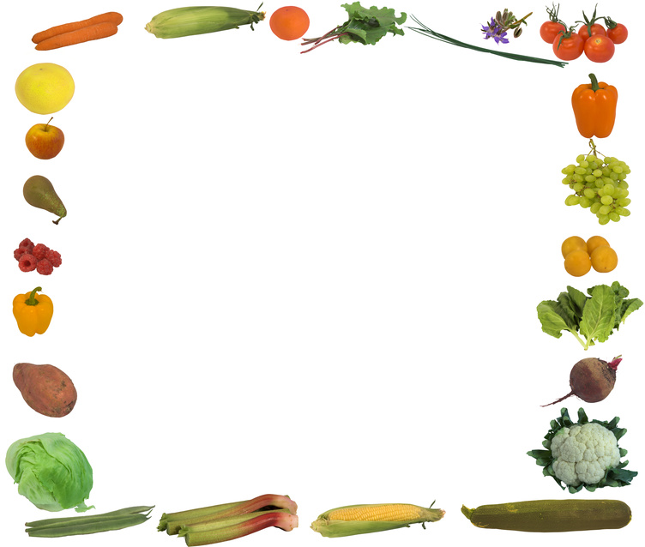


Activity for this lesson…

Slide 38
