Slide 1
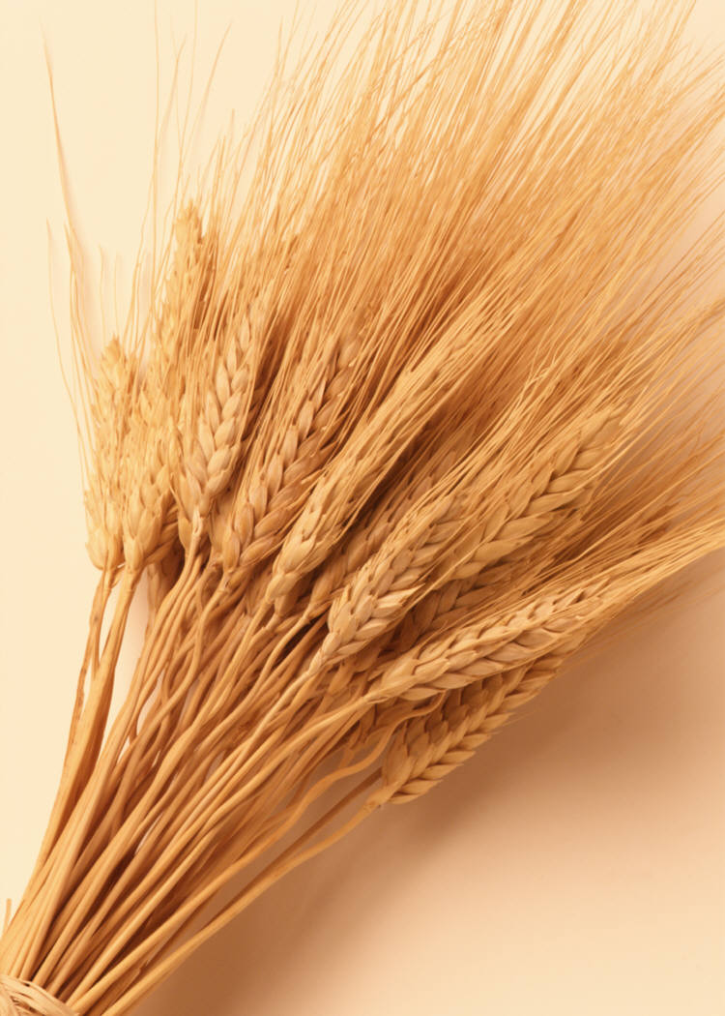
Sabeel ul Huda Lesson 35
Surah Al-Baqarah:
261-266

Slide 2
Topic of verses
Rewards of spending in Allah’s cause [261]
To remind about charity given is forbidden [262-264]
The example of those who spend to seek the approval of Allah [265]
The example of evil deeds nullifying good deeds [266]

Slide 3
Verse 261
﴿مَّثَلُ الَّذِينَ يُنفِقُونَ أَمْوَلَهُمْ فِي سَبِيلِ اللَّهِ كَمَثَلِ حَبَّةٍ أَنبَتَتْ سَبْعَ سَنَابِلَ فِي كُلِّ سُنبُلَةٍ مِّاْئَةُ حَبَّةٍ وَاللَّهُ يُضَـعِفُ لِمَن يَشَآءُ وَاللَّهُ وَسِعٌ عَلِيمٌ ﴾
The example of those who spend their wealth in the way of Allah is like a seed [of grain] which grows seven spikes; in each spike is a hundred grains. And Allah multiplies [His reward] for whom He wills. And Allah is all-Encompassing and Knowing.

Slide 4
The multiplication of rewards…
This is a comparison that Allah made of the multiplication of rewards for those who spend in His cause.
Allah multiplies the good deed ten to seven hundred times.
This Ayah indicates that Allah `grows' the good deeds for its doers, just as He grows the plant for whoever sows it in fertile land.

Slide 5
Verse 262 - 263
﴿الَّذِينَ يُنفِقُونَ أَمْولَهُمْ فِى سَبِيلِ اللَّهِ ثُمَّ لاَ يُتْبِعُونَ مَآ أَنْفَقُواْ مَنّا وَلا أَذًى لَّهُمْ أَجْرُهُمْ عِندَ رَبّهِمْ وَلاَ خَوْفٌ عَلَيْهِمْ وَلاَ هُمْ يَحْزَنُونَ قَوْلٌ مَّعْرُوفٌ وَمَغْفِرَةٌ خَيْرٌ مّن صَدَقَةٍ يَتْبَعُهَآ أَذًى وَاللَّهُ غَنِىٌّ حَلِيمٌ

Slide 6
Verse 262-263 - Translation
Those who spend their wealth in the way of Allah and then do not follow up what they have spent with reminders [of it] or [other] injury will have their reward with their Lord, and there will be no fear concerning them, nor will they grieve.
Kind speech and forgiveness are better than charity followed by injury. And Allah is Free of need and Forbearing.

Slide 7
Reminding people of the charity given…
“or [other] injury” - They do not cause harm to those whom they gave the charity to, for this harm will only annul the charity.
There are several Hadiths that prohibit reminding people of acts of charity.

Slide 8
Verse 264
يأَيُّهَا الَّذِينَ ءامَنُواْ لاَ تُبْطِلُواْ صَدَقَـتِكُم بِالْمَنّ وَالاْذَى كَالَّذِى يُنفِقُ مَالَهُ رِئَآء النَّاسِ وَلاَ يُؤْمِنُ بِاللَّهِ وَالْيَوْمِ الاْخِرِ فَمَثَلُهُ كَمَثَلِ صَفْوَانٍ عَلَيْهِ تُرَابٌ فَأَصَابَهُ وَابِلٌ فَتَرَكَهُ صَلْدًا لاَّ يَقْدِرُونَ عَلَى شَىْء مّمَّا كَسَبُواْ وَاللَّهُ لاَ يَهْدِي الْقَوْمَ الْكَـفِرِينَ﴾

Slide 9
Verse 264 - Translation
O you who have believed, do not invalidate your charities with reminders or injury as does one who spends his wealth [only] to be seen by the people and does not believe in Allah and the Last Day. His example is like that of a [large] smooth stone upon which is dust and is hit by a downpour that leaves it bare. They are unable [to keep] anything of what they have earned. And Allah does not guide the disbelieving people.

Slide 10
The person who gives charity to show-off…
The charity will be rendered in vain if it is followed by harm or reminders.
The boasting person pretends to give away charity for Allah's sake, but in reality seeks to gain people's praise and the reputation of being kind or generous, or other material gains of this life.
The example of who gives charity to show-off: “His example is like that of a [large] smooth stone”
This Ayah means that heavy rain left the Safwan completely barren of dust. Such is the case with Allah's action regarding the work of those who show off, as their deeds are bound to vanish and disappear.

Slide 11
Verse 265
﴿وَمَثَلُ الَّذِينَ يُنفِقُونَ أَمْوَلَهُمُ ابْتِغَآءَ مَرْضَاتِ اللَّهِ وَتَثْبِيتًا مِّنْ أَنفُسِهِمْ كَمَثَلِ جَنَّةٍ بِرَبْوَةٍ أَصَابَهَا وَابِلٌ فَأَتَتْ أُكُلَهَا ضِعْفَيْنِ فَإِن لَّمْ يُصِبْهَا وَابِلٌ فَطَلٌّ وَاللَّهُ بِمَا تَعْمَلُونَ بَصِيرٌ ﴾ And the example of those who spend their wealth seeking means to the approval of Allah and assuring [reward for] themselves is like a garden on high ground which is hit by a downpour - so it yields its fruits in double. And [even] if it is not hit by a downpour, then a drizzle [is sufficient]. And Allah , of what you do, is Seeing.

Slide 12
The believer’s good deeds…
They are certain that Allah shall reward them for these righteous acts with the best rewards.
The Ayah indicates that the garden on the Rabwah is always fertile, for if heavy rain does not fall on it, light rain will suffice for it. Such is the case regarding the believer's good deeds, for they never become barren.
Allah accepts the believer's righteous deeds and increases them, each according to his deeds.

Slide 13
Verse 266
﴿أَيَوَدُّ أَحَدُكُمْ أَن تَكُونَ لَهُ جَنَّةٌ مِّن نَّخِيلٍ وَأَعْنَابٍ تَجْرِى مِن تَحْتِهَا الأَنْهَـرُ لَهُ فِيهَا مِن كُلِّ الثَّمَرَتِ وَأَصَابَهُ الْكِبَرُ وَلَهُ ذُرِّيَّةٌ ضُعَفَآءُ فَأَصَابَهَآ إِعْصَارٌ فِيهِ نَارٌ فَاحْتَرَقَتْ كَذَلِكَ يُبَيِّنُ اللَّهُ لَكُمُ الآيَـتِ لَعَلَّكُمْ تَتَفَكَّرُونَ ﴾

Slide 14
Verse 266 - Translation
Would one of you like to have a garden of palm trees and grapevines underneath which rivers flow in which he has from every fruit? But he is afflicted with old age and has weak offspring, and it is hit by a whirlwind containing fire and is burned. Thus does Allah make clear to you [His] verses that you might give thought.

Slide 15
The example of the disbeliever…
This is the condition of the disbeliever on the Day of Resurrection when he returns to Allah, for he will not have any good deeds to provide an excuse - or refuge - for him, just as the man in the example had no strength to replant the garden.
The disbeliever will not find anything to resort to for help, just as the offspring of the man in the example did not provide him with help.

Slide 16
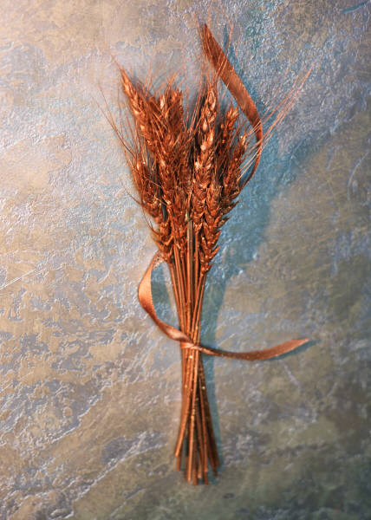
Activity

Slide 17
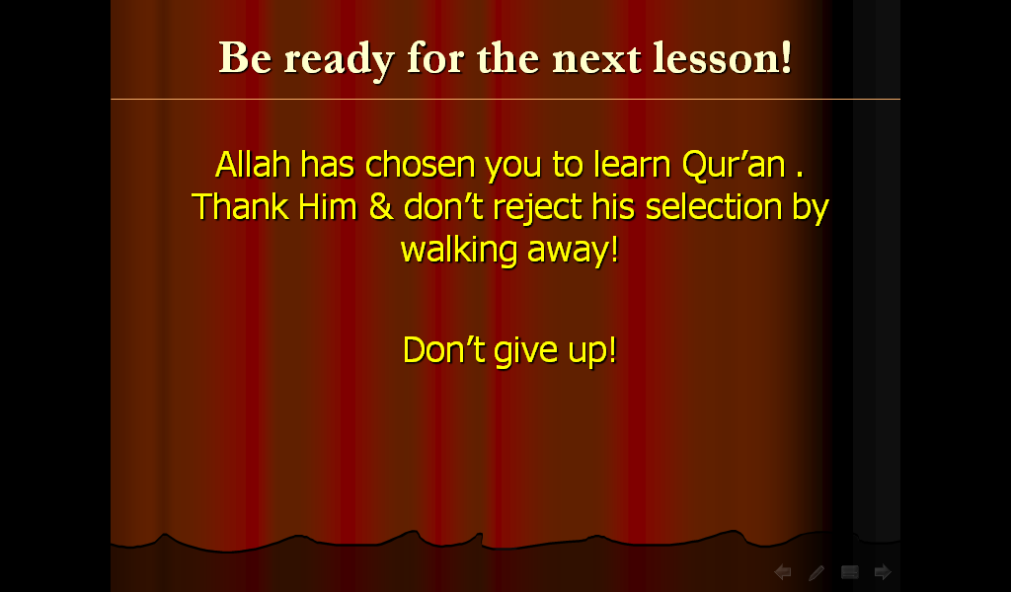
Alhamdulillahi Rubbil Almeen

