Slide 1
Sabeel-ul-Huda
Lesson 13
(Al-Baqarah: 75-82 )

Slide 2

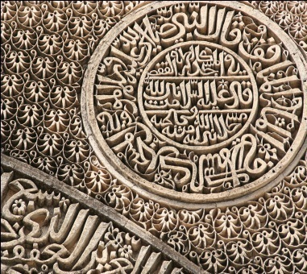
Tafseer

Slide 3
2 Groups of Jews & their Behavior
Notes:
Story of Adam and iblees

Slide 4
Main Topics of Lesson
Ulma e Yahud/ they will not believe in your religion 2:[75-77]
Ummyyun people/ they do nothing but conjecture 2:[78-79]
Khushfehmiyan 2:[80]
Those who seek gain in evil, and are girt round by their sins 2: (81)
Jannat amal ka phal 2:[82]

Slide 5
Background of Verses…
There were 2 groups of Jews in Madina.
Ulama
Awaam
Whole lesson is about their atitude

Slide 6
Ayat 75—أَفَتَطْمَعُون
Hope that they will believe.
A party of them heard the Word of Allah, and perverted….
أَفَتَطْمَعُونَ – Tua Meem-Ain. Greed with hope,
Hope of someone’ s benefit
فَرِيۡقٌ- Fa – Ra- Qaaf- different

Slide 7
Yahud ke Ulma ki Khyantyn
Allah ka qalam jan bojh kar badalna
do rawaye mohafiq
haq ko chupaty hai
apne hath se kitab likh kar Allah ki batatye hai
Ayat bechtay hai

Slide 8
Ayat 76 وَإِذَا لَقُواْ ٱلَّذِينَ ءَامَنُواْ
when they meet the muslims, they say: "We believe":
"Do you talk to them about what Allah has revealed to you
اَ تُحَدِّثُوۡنَهُمۡ
لِيُحَآجُّوۡكُمۡ

Slide 9
Ayat 77. أَنَّ اللَّهَ يَعْلَمُ مَا يُسِرُّون
Allah knows
جو کچھ یہ چھپاتے اور جو کچھ ظاہر کرتے ہیں

Slide 10
Ayat 78 وَمِنۡہُمۡ أُمِّيُّونَ
. there are among them illiterates
who know not the Book
but (see therein their own) desires
they do nothing but conjecture
اُمِّيُّوۡنَ
يَظُنُّوۡنَ‏
‘

Slide 11
Aam yahud
Kitab kay bare may babunyah bate
veham aur guman
kitab ka ilam nahi

Slide 12
Ayat 79 فَوَيۡلٌ۬ لِّلَّذِينَ يَكۡتُبُونَ
Write the book with their own hands and then say, "This is from Allah,''
to purchase with it a little price!

Slide 13
Ayat 80 لَن تَمَسَّنَا ٱلنَّارُ
They will only remain in the Fire for a Few Days
"Have ye taken a promise from Allah,
Allah never breaks His promise
يَشۡتَرُوۡ
مَّعۡدُوۡدَةً

Slide 14
Ayat 81 بَلَىٰ مَن كَسَبَ سَيِّئَةً۬
Those who seek gain in evil, and are girt round by their sins
خَطِيْۤـــَٔتُهٗ
اَحَاطَتۡ

Slide 15
Ayat 82 والَّذِينَ ءَامَنُواْ
They shall be among the people of Paradise
For ever

Slide 16


