Slide 1
Sabeel-ul-Huda
Lesson 10
(Al-Baqarah: 49 -60 )

Slide 2

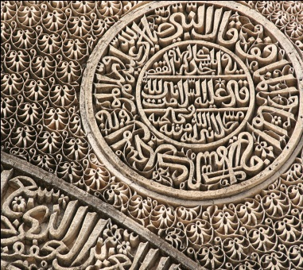
Tafseer

Slide 3
Fall & Arise of Bani israeel
Notes:
Story of Adam and iblees

Slide 4
Main Topics of Lesson
Israelites' deliverance from Pharaoh's persecution: 2:[49-50]
Their sin of worshipping the Calf. 2:[51-52]
Their repentance through slaying the culprits. 2:[53-54]
Those who wanted to see Allah face to face were put to death, then …Allah gave them life again and provided them with heavenly food. 2:[55-57]
Their discontent and disbelief. 2:[58-59]
Miracle of providing water in the desert from a rock. 2:[60]
Israelites rejected the heavenly food and
Their disobedience and transgression. 2:[61]

Slide 5
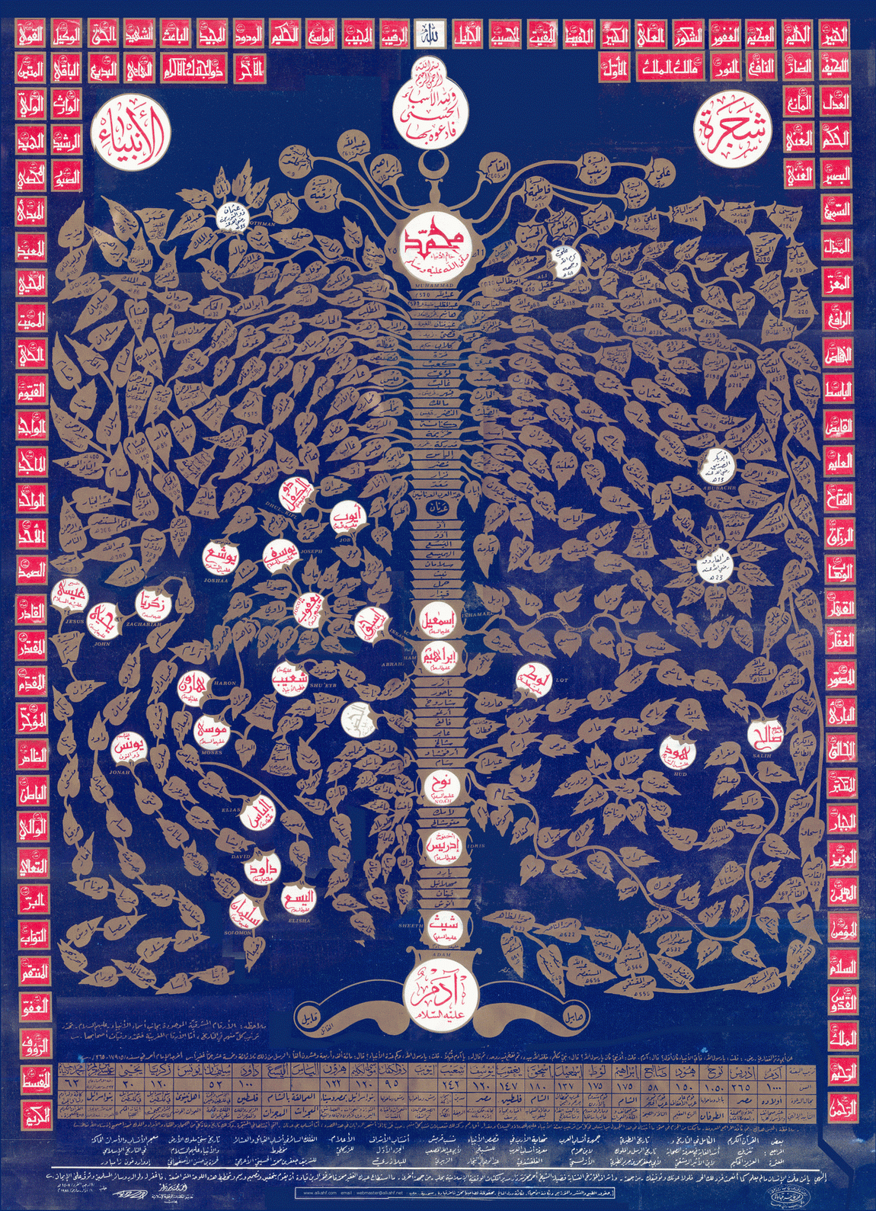
Prophets Tree
Notes:
Adam > Shabeeh > Idrees > Nuh (iss daur med hi shirk shuro huwa) > Ibrahim (Loot inn ke cousin the) > Ismail > Muhammad (sallal-lãhu ’alayhi wa sallam)
Se på nederst til vesntre på kartet, det er det Bani Israil var stolt av; slektskapet deres

Slide 6
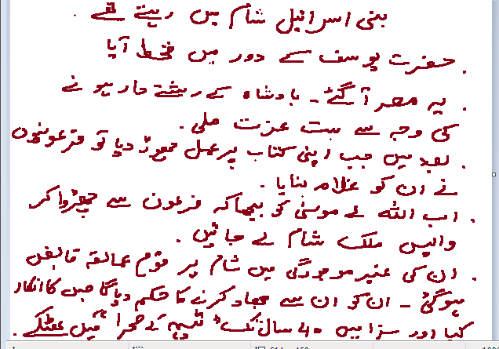
Histroy of Bani isaeel……
How they came to Egypt ?
Notes:
Bani Israil Shaam me rehte the
Hazrat Yusaf a.s. jo hazrat Yaqoob a.s. ke bete the, who kuch deer ke liye Egypt ke finansminister (?) bann gaye
Bani Israil ne apni kitaab pe amal karna choor dya, aur yeh uss daur ke musalman the.
Bani Israil do khuwahishaat rakhte the: 1) Fir’aun se nijaat 2) deen sikhane wala ajaye. Allah ta’ala ne inn ki du’a qabool farmai.
Moosa a.s. ko bheja, aur do hukam dye: 1) Fir’aun se inhe chorao 2) Inhe wapis Shaam le ke jao
Fir’aun doob gaya,
Peeche ek Amalqa naam ki qaum ne hamla karr lya. Allah ta’ala ne Musa a.s. paigham dya ke qaum-e-Mualqa ke saath jihaad karro aur tumhe who jagah mill jayegi

Slide 7
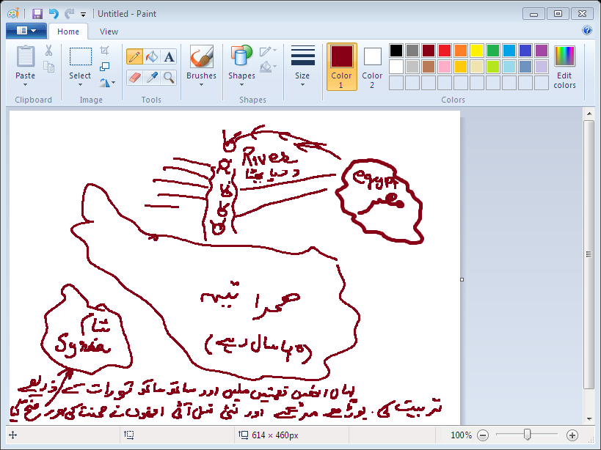
Mind Map of their migration
Notes:
Yeh planning he mulk Shaam tak pohanchne ki, aur Bani Israil ko azaad karwane ke liye. Pehle inn se Musa a.s. ne kaha ke ghar banao kinaro par. Phir unhe kaha ke iss samundar (river) se paar hojao. To peeche hi Fir’aun aa raha tha. Inn ke liye Allah ta’ala ne samundar ko paar dya. Magar jab Bani Israil guzar gaye, aur Fir’aun ka lashkar peeche aaraha tha, to samundar mill gaya.
Sehra-e-tee: Iss sehra me yeh qaum 40 saal batkti rahi. Yahan Mann o salwa mila, clouds ke saaye huwe inn pe. Aur issi dauraan Toraat nazil huwi. Toor pahaar bhi iss sehra me he.
Phir inn ki who poori nasal marr gai jinho ne inkaar kiya Shaam me ja ke jihaad karne ka.
Issi dauraan hazrat Musa a.s. faut hogaye, aur Haroon a.s. bhi aaye. Phir Yooshe bin Noon aaye.

Slide 8
Aya 49 ……Wa iz nujynakum…
2 missions of Mosa as;_
To freeof Bani israeel from Firoun
To do Terbeyah of Bani israeel…(Taurah).
Here is complition of first mission
Allah swt reffers nijat to Himself.

Slide 9
Aali firawn…..
Alif –waw- lam
Aal = to turnto someone to support
Nation,suporters, like minded ppl. Same embitions, (Ali ibrahim)
Title of misri rulars was Firown.
Ra-ain
Kirn , soruj duta,
2 Firous at the time of Musa.
Ramsees
Minfitah
Notes:
2 Fir’aun Musa a.s. ke daur me: Ram sees aur Min-fitah
Fir’aun = Sooraj devta ka awtar (Soraj ki awilad/dummy,naozbillaa)
Loog Fir’aun ko isslye sajdah karte ke, Soraj ne yeh dummy bheja he

Slide 10
Yasumoonakum..
Seen- waw -Meem
Bujh dalna , pressurize kerna, Gazing ky ly animals ko ly ker jana, mushuqqat my dalna.
Why they kill?

Slide 11
Yuzubbihoona...
Why they do this ?
=Population control
Dream of a farow
To tease them
Ibn …..Exploit their love,
Nissa….Exploit their Gyraat. Kaneezyn,
Alternate year to kill sons.
Free labour ,pyramids builders
Forced petience/jabri of bani israeel-------successded & vice versa is very hard,,they failed
Notes:
Kion zabah karte the? Ta ke musalman bharr na sake, unn ki naslo ko barbad karna chahte the. Population kum karna chahte the
Musa a.s. uss saal peda huwe, jiss saal bacho ka qatal hona tha

Slide 12
Blaun mir Rubbikum Azeem
Instead of Firoun Allah mension :’ Mirubbikum:’
Controlling hand is my Rubbs
No one can inject a child if mother dont permit.....child hides in mothers lap...
AnyTrail is not bad for a believer ,even it seems bad
Notes:
Kissi qaum pe zalim hukmeran aajaye, to who uss qaum pe aazmaish hoti he
Allah ta’ala ne khud farmaya hazrat Musa a.s. ke agar tum pe hukmeran bora ho to samajh lena Me naraaz ho og omvendt
Koi bhi azmaish bori nahin hoti (?)
Bani Israil ka yeh sabar ka daur tha, jabri sabar.

Slide 13
Ayat 50 wa iz faruqqna…..
In Short……style
Out of context tafseer shows…firoun was drown suddunly , but reality is not this. In between were many years ,,, (almost 40 years)
Splitting the river was blessing for Bi but was azaab for Fr ,,,moral. Don’t jeoulus from anyone,s blessing.
Some colours suits someone but not to other,
Notes:
Fir’aun ne hi rivaaj peda kiya soli pe charhane ka

Slide 14
Ayat 51,, wa iz waudna Musa..
Time of fulfilling musa,s 2nd Mission.
Taurah was not revealed in the life of Farown
Q- Why Musa went to Taurah
To be focus.
Qurbani of lovely things
Notes:
Bani Israil jab azaad huwe Egypt se, to raaste me kuch loogon ko gao ki prastish karte huwe dekha.
Fir’auni … me gao ki prastish ki jati, aur inn ko who rasam bohat achi lagi
Inho ne ek shakhs ko sara sona dya, aur uss ne blande karr ke uss ka ek bachra bana dya, jiss ke peet me kuch pattar dale.
Harr rasam ke peeche ek rasam he (maslann mehndi ke din peela rang, rakhi bandhna etc.)
Inho ne samjha hazrat Msua a.s. nahin wapis ayenge, to inho ne shirk karna shuro karr dya

Slide 15
Summa athuztum ul ijala.
Bani israeel failed in Ikhtyari petience . (just like we pakistani)
Influenced from pagon culture
Zalimoon = Mushriqoon
Have bud gumani about Musa.he forgot..

Slide 16
Ayat 52 suma afauna …tushkuroon
One more chance
If you miss one chance.dont miss other.
Notes:
Shukar: 1) dil se admit karna ne’maton ko 2) zubaan se alhamdolillah kehna 3) amal se shukar karna (who kaam karna, jiss se ne’mat dene wala khush ho)
Aaj ka sooraj isslye nikle tha, la’allakum tashkuruun

Slide 17
Ayat 53.wa iz…tahtadon
Purose of sending books , is to guide not to do everything else…
Chuman,
Qasam khana
Taweez
Jin bhut baghana
Weddings my barakat ky liy. etc
Notes:
Kissi cheez se hidayat lene ke liye usse samajhna zarori he

Slide 18
Ayat 54 .wa iz qaala…alraheem
It was the punishment of Irtidaad/
Just like doctor cuts the defected part.
Bari……….Paintor only discord ugly paintings
Notes:
Baari-ikum: Allah ta’ala ka naam > peda karne wala
Pichli qaumo me tawbah bohat sakht thi
Ab unn me koi kheyr hi nahin rahi

Slide 19
Ayat 55;- wa iz kultum…Tunzuroon
Bani israeel has the deseas of doubt about their prophets
Negetive Atitude
Their wish ’To see Allah swt ‘’ was not out of love.
Notes:
Inke religious leaders nikle, 70 sardaar, aur unn ke Allah ta’ala ne hukam dya ke Toor pe le ke aao. Who isslye tha kionke yeh yaqeen nahin the karr rahe ke Toraat Allah ta’ala ki taraf se

Slide 20
Ayat 56.Summa Bausnakum..tushkroon
One more chance to their relegous leaders

Slide 21
Ayat 57…Wa Zullna alykum algmam
Za-lam-lam
Gain-meem-meem
Chaa jjana
White unmbrella for them
Notes:
Ghamaam: ghum
Mann = 1) ehsaan 2) jab subah hone wali hoti thi, to kuch niche aata, to yeh kehte ”mann” (kese?) (?)
Hukam kya tha? Ke ikhatta na karro, rozana taza khana milega. Magar inho ne ikhatta karna shuro karr dya

Slide 22
Almun wa salwa……
Meem-nun-nun
Who----strange thing was
Ahsaan ,favour kerna
Like Dew drops. Gum, and melt with sun rays
Salwa- white meet, Birds
Do We have munn Salwa?
‘’ Nothing to eat ’’

Slide 23
wma Zalamoona…
Zulm ?
= Greed
Forgot the mision and want tasty food
Notes:
Unn ka zulm kya tha? nashukri

Slide 24
Ayat 58-59 wa iz ……….Yafsaqoon
Scatored stories from their history
Hittatun = gunnah jarh dy.
Notes:
Sujjadann: iss se muraad litterally sajdah nahin, magar aajzi ekhtyar karna jab koi ne’mat mile
Yahan se maloom hota he ke jashan ki bajaye shukarguzaar og ydmyk hona chahye. Maslann jab Pakistan azaad huwa.
Inho ne hittatunn ki bajaye hiintatunn kehna shuro karr dya
Ta’wn (choohe wali) bemari: Rijzam-minas-sami

Slide 25
Ayat 60 wa iz istisqa….mufsideen

Slide 26
