Slide 1
Sabeel-ul-Huda
Lesson 11
(Al-Baqarah: 61 -66 )

Slide 2

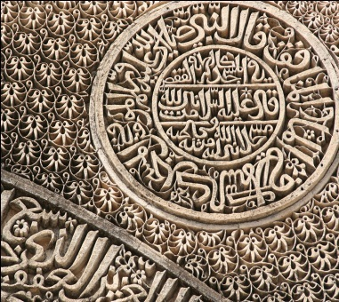
Tafseer

Slide 3
Disobedience and Transgression of Bani Israeel
Notes:
Story of Adam and iblees

Slide 4
Main Topics of Lesson
Their disobedience and transgression. 2:[61]
Real believers have nothing to fear or to regret. 2:[62]
Israelites covenant with Allah: 2:[63-64]
Punishment for the violation of the Saturday2:[65-66]

Slide 5
Ayat 61 Wa iz…yautadoon
Journy from Problems. (Allah saved them from Farrow).>>>Needs (Munn wa salwa)>>>wants (desires)(we want tasty food)>>> they feel desires are our Right.
Disrespectfull styl to call prophet (influence of Farrow culture)
Pagons don’t call Alah,s directly.
Even don’t pray by themselves
Your Lord ‘ shows that they don’t want to face Allah swt because of their sins.
Dua is a conection between Allah,s and Slaves
Yikhrij------------sign of their Laziness. “ we don’t want to work hard.
Notes:
Iss ayat me ek rawayye ka izhaar he
Kiss pe sabar nahin hota? Ek tarha ke khane pe
Ta’aam: khaane aur piine, dono ke liye aata he
Du’a khud nahin karr rahi Bani Israil
Kaha pukaro Rabbaka (apne Rabb ko). Khud du’a nahin maang rahe the. Kion? Kionke Allah ta’ala se unn ka apna ta’lluq kamzoor tha
Baaz dafa du’a na mangna takabbur hote he
Yukhrij: iss se inn ki sosti nazar aati he
Baqlihaa: (haa = dunya)
Qiththããihaa: kheera
Faumihaa: 2 meanings; 1) thaum/pyaaz 2) …
Aala cheez se adna: 1) asmaani rizq 2) zameen ka rizaq, 1) Allah ta’ala chahte the ke yeh chune huwe loog he, inn ka maqsad kionke deen ka philana he, to yeh kahan khano ke kaamo me mubtala rahenge. Allah ta’ala ne chaha ke yeh iss kaam ki fikar na karre (Allah ta’ala ka naam: Razzaaq)
Yeh ghulami he agar insaan apne peet bharne ke liye kaam karte he. Kionke khana khilne wali zaat to Allah ta’ala ki he

Slide 6
Lun Nusbira…
4 things needed to prevent Fsaad.
Shukar
Sabar
Twazu (humbleness)
Qnaat (thore pe razi, saadgi)
Notes:
Kissi bhi qaum ke andar Allah ta’ala ki nafarmaniya aati he, to
Aaj Muslimah-ummat bhi nashukri ka shikaar he
Yeh 4 cheeze harr insaan ki zarorat he, aur Muslimah-ummat ko bhi yeh chahye hongi fasaad khatam karne ke liye
Shukar: utilize karre yeh shukar

Slide 7
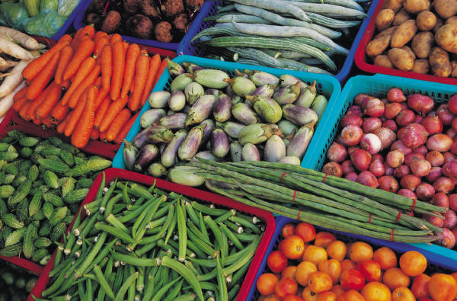
Were they in a Resturant ?
They can ask big thingd, but their mental level was very low
Example of standing in front of any embessider of a superpower…
They became taste concious.
They forgot the “ Mission”
They can ask big things like,,,,,,,Bravery, courage, wisdom, victory etc
WE can check our Duas…what we mostly ask?

Slide 8
Ihbitu Misrun……..
Musa as become
angry
Disopointed
Sad.
Alalhs punishment on them……
”They got whatever they want.”
They were free from Farow and were slaves of their desires now.
Notes:
”They got whatever they want” – yeh ek saza thi
Esi saza kiss ko milti he? Unn qaumo ko jo khwahish ke ghulam hojati he

Slide 9
Zuribut alyhim..izzilat
Result of their
Forgetting the Mission and running after desires.
Why we muslim are opressed and non muslims are domenent now a days….?
We can compare our and their weddings.
,,,,,,,,,,,,,,,,,,,,,,,,,,,,,,,,,,,,,,,,,,,,,,,, Wakinng up time
,,,,,,,,,,,,,,,,,,,,,,,,,,,,,,,,,,,,,,,,,,,,,, sincerity to their work
Etc.
Notes:
Iss qaum ka haal yeh kion huwa > wa duribat ’alayhimudh-dhillatu walmaskanah? Kionke inho ne khuwahish ki ghulami ki
Yeh 1 din me 300 nabiyo ka qatal karte (misaal: Zakariyya a.s. aur Yahya a.s.)

Slide 10
Kanu yukforron…….yuqtuloon
They start killing every one who came on the way of their desires
They killed
Prophet Yahha.
,,,,,,,,,,,,,,,, Zakaria
………. Yermia
Tried to kill Eesa aslm

Slide 11
Zalika bima Asuw….yatadoon
Comparison of Muslims (now a days) and Bani israeel

Slide 12
Ayat 62
  Deniel of the consept of Uni Religion
  (Wahdata Adyaan.)
  No one will enter to Jannah because of His Name only
Notes:
Saabaiin = The rise. Yeh ese loog the jo Qible ki tara ho ke namaazz parhte the.
Wahdat-e-ayaan: har madhab ki achi baatein le lo, aur sab ko mila ke ek madhab bana lo. Iss ka aghaaz Pak-o-hind me Akbar ne kiya
Islam apne andar kuffar ki ek chint bhi bardasht nahin karr sakta
Amal-saleh: 1) khalis Allah ta’ala ke liye ho 2) Nabi (saws) ke tariqe ke mutabiq ho)

Slide 13
Ayat 63,wa iz ahuzna….
Punishment of Denying Taurah,s Ahkamat.
Meesaq = imp matters promiss,with the sense of responsibilty.
Toor = mountain on which musa spoke to Allah swt. Its suryaani lanuage
It was not forced ahad, but it was sign of Allah,s majasity…He can squeez you under the mountain.
Notes:
Toor apni jagah se uth gaya, aur yeh darr se sajdeh me girr gaye
Aaj bhi Yahood yeh sajdah karte he
Toor: koi bhi pahaar. At-Toor: who pahar jiss pe Musa a.s. ko Toraat mili
Allah ta’ala ki kitaab ko mazboti se thaamo, yeh hukam dya ja raha he. Jo loose haatho se cheez pakri jati he, who dil me nahin bhasti

Slide 14
Ayat 64…Summa twullytum
They again transgressed after seeing big sign of Allah swt,
Notes:
Allah ta’ala ka fazal aur rehmat: uss bande pe hota he jo harr haal me iss kitaab ko mazbooti se thame rakhe
3 attitude of Bani Israil: 1) Allah ta’ala se kiya huwa ehad tora 2) hila sazi (plotting, trick y attitude) (ayah 65-66) 3) hujjat bazi (why? Kion?) (agle lesson me ayega)

Slide 15
Ayat 65 -66
This happened in the time of Prophet Dawood as
1000 years ago from prophet Easa as.
They find loopwholes in
Shariat
They distored Shariat , Allah swt distorted their faces.
Hadith:.people ask about Apps….
Name of the town was “ Eela”
They try to trick Allah swt ,Allah trapped them
Sabat = To cut , mean Hoiday
Friday was holiday from the beginning but they chose Satuday.
It was physial distortion not mental.
Ibrat is the punishment that prevent others to do that sin.
Notes:
Yeh waqya kab huwa? Hazrat Dawud a.s. ke daur me, hazrat Isa a.s. ke ek saal aane se pehle (aaj bhi yeh jagah mujood he Jerusalem ke paas)
Jab se dunya bani thi, Allah swt ne Friday ko holiday banaya. Holiday = religious day. Allah ta’ala chahte the ke least ek din insaan ki zindagi ka esa ho, ke sirf aur sirf Allah ta’ala ke liye ho
Hazrat Adam a.s. se le kar hazrat Musa a.s. se le kar yehi din holiday raha
Bani Israil ne Saturday holiday rakhna chaha, aur Allah ta’ala ne inhe ijazat de di. Baad me jab hisai aaye to unho ne Sunday ka din choose karr lya.
sabbt = cut (sab cut karr do, dukane band, job se chutti osv)
Iss waqye ke muttaliq surah Al-’Araaf me kuch aytein he
Jumme ke waqt jo mard khutbe aur jumme ki namaaz me dunya ke kaamo se cut na ho, to usski who kamai jo iss time me kamaye, who haraam he. Magar yahodiyo pe poora din kamana mana tha
Inn ke 3 gruh hogaye iss waqya ke baad: 1) jinho ne hila kiya 2) jinho ne inhe mana kiya 3) na mana kiya, na kuch kaha
Aap ko aaj bhi ese 3 gurh milenge
Qiradatunn = aper
Jo bandar banaye gaye the unn ki 3 din se zyaada nasal na rahi
Bandar hi kion banaya? 1) nakle utarte the 2) harr cheez ko mazakh leta he, serios nahin leta osv.
Rivayaat: kuch ese loog honge musalmano me, jo khanzeer bane ge Qayamat ke qareeb.
Qayamat ke qareeb kuch musalman bhi bandar bane ge (?)
Hadith: meri ummat ke kuch loog sharaab ka naam badall ke, usse piyenge. Kuch ghane ka naam badall ke usse jaiz karr lenge. Osv.
Qayamat ke din jo chughliya og lignende ka amal karte he, to wh Qayamat ke din dog’s ki shaklo me honge
Tibret (?) naam ki jagah me kuch loog bandar bann gaye

Slide 16
