Slide 1
Sabeel-ul-Huda
Lesson 5 (Al-Baqarah: 17-20)

Slide 2
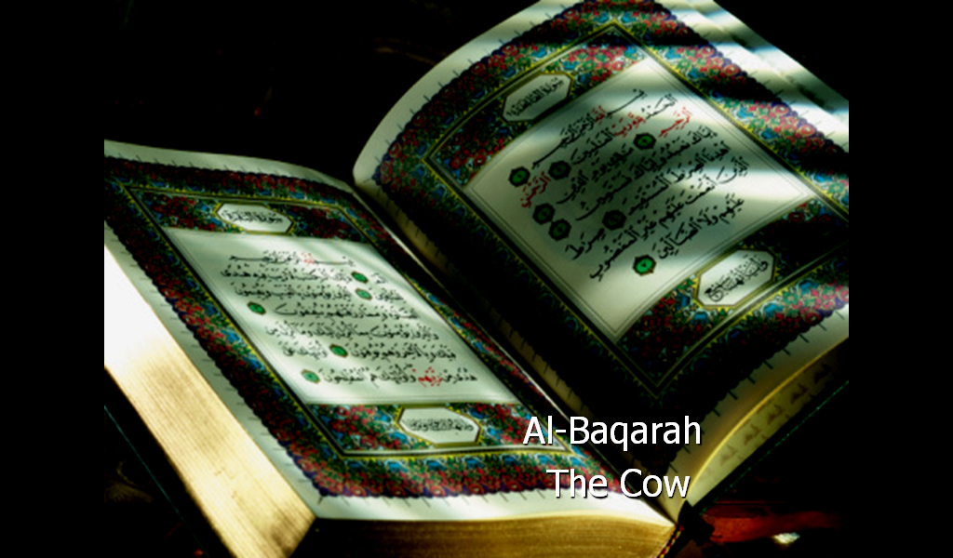

Slide 3
مَثَلُهُمۡ كَمَثَلِ ٱلَّذِى ٱسۡتَوۡقَدَ نَارً۬ا فَلَمَّآ أَضَآءَتۡ مَا حَوۡلَهُ ۥ ذَهَبَ ٱللَّهُ بِنُورِهِمۡ وَتَرَكَهُمۡ فِى ظُلُمَـٰتٍ۬ لَّا يُبۡصِرُونَ (١٧)
صُمُّۢ بُكۡمٌ عُمۡىٌ۬ فَهُمۡ لَا يَرۡجِعُونَ (١٨)
أَوۡ كَصَيِّبٍ۬ مِّنَ ٱلسَّمَآءِ فِيهِ ظُلُمَـٰتٌ۬ وَرَعۡدٌ۬ وَبَرۡقٌ۬ يَجۡعَلُونَ أَصَـٰبِعَهُمۡ فِىٓ ءَاذَانِہِم مِّنَ ٱلصَّوَٲعِقِ حَذَرَ ٱلۡمَوۡتِ‌ۚ وَٱللَّهُ مُحِيطُۢ بِٱلۡكَـٰفِرِينَ (١٩)
يَكَادُ ٱلۡبَرۡقُ يَخۡطَفُ أَبۡصَـٰرَهُمۡ‌ۖ كُلَّمَآ أَضَآءَ لَهُم مَّشَوۡاْ فِيهِ وَإِذَآ أَظۡلَمَ عَلَيۡہِمۡ قَامُواْ‌ۚ وَلَوۡ شَآءَ ٱللَّهُ لَذَهَبَ بِسَمۡعِهِمۡ وَأَبۡصَـٰرِهِمۡ‌ۚ إِنَّ ٱللَّهَ عَلَىٰ كُلِّ شَىۡءٍ۬ قَدِيرٌ۬ (٢٠)

Slide 4
Translation

Slide 5
Ayah 17
مَثَلُهُمۡ كَمَثَلِ ٱلَّذِى ٱسۡتَوۡقَدَ نَارً۬ا فَلَمَّآ أَضَآءَتۡ مَا حَوۡلَهُ ۥ ذَهَبَ ٱللَّهُ بِنُورِهِمۡ وَتَرَكَهُمۡ فِى ظُلُمَـٰتٍ۬ لَّا يُبۡصِرُونَ
Their example is that of one who kindled a fire, but when it illuminated what was around him, Allah took away their light and left them in darkness [so] they could not see.

Slide 6
Ayah 17 – word for word
ٱلَّذِى
(of) the one who
كَمَثَلِ
(is) like (the) example
مَثَلُهُمۡ
Their example
أَضَآءَتۡ
it lighted
فَلَمَّآ
then, when
نَارً۬ا
a fire,
ٱسۡتَوۡقَدَ
kindled
فِى
in
وَتَرَكَهُمۡ
and left them
بِنُورِهِمۡ
their light
ذَهَبَ ٱللَّهُ
Allah took away
لَّا يُبۡصِرُونَ
(so) they (do) not see.
ظُلُمَـٰتٍ۬
darkness[es],

Slide 7
Ayah 18
صُمُّۢ بُكۡمٌ عُمۡىٌ۬ فَهُمۡ لَا يَرۡجِعُون
Deaf, dumb and blind – so they will not return [to the right path].

Slide 8
Ayah 18 – word for word
عُمۡىٌ۬
blind,
بُكۡمٌ
dumb,
صُمُّۢ
Deaf,
لَا يَرۡجِعُونَ
[they] will not return.
فَهُمۡ
so they

Slide 9
Ayah 19
أَوۡ كَصَيِّبٍ۬ مِّنَ ٱلسَّمَآءِ فِيهِ ظُلُمَـٰتٌ۬ وَرَعۡدٌ۬ وَبَرۡقٌ۬ يَجۡعَلُونَ أَصَـٰبِعَهُمۡ فِىٓ ءَاذَانِہِم مِّنَ ٱلصَّوَٲعِقِ حَذَرَ ٱلۡمَوۡتِ‌ۚ وَٱللَّهُ مُحِيطُۢ بِٱلۡكَـٰفِرِين
Or [it is] like a rainstorm from the sky within which is darkness, thunder and lightning. They put their fingers in their ears against the thunderclaps in dread of death. But Allah is encompassing of the disbelievers.

Slide 10
Ayah 19 – word for word
ظُلُمَـٰتٌ۬
darkness[es]
فِيهِ
in it (are)
ٱلسَّمَآءِ
the sky
مِّنَ
from
كَصَيِّبٍ۬
like a rainstorm
أَوۡ
Or
فِىٓ
in
أَصَـٰبِعَهُمۡ
their fingers
يَجۡعَلُونَ
They put
وَبَرۡقٌ۬
and lightning.
وَرَعۡدٌ۬
and thunder,
ٱلۡمَوۡتِ‌ۚ
[the] death.
حَذَرَ
(n) fear (of)
ٱلصَّوَٲعِقِ
the thunderclaps
مِّنَ
from
ءَاذَانِہِم
their ears
بِٱلۡكَـٰفِرِينَ
the disbelievers.
مُحِيطُۢ
(is) [the One Who] encompasses
وَٱللَّهُ
And Allah

Slide 11
Ayah 20
يَكَادُ ٱلۡبَرۡقُ يَخۡطَفُ أَبۡصَـٰرَهُمۡ‌ۖ كُلَّمَآ أَضَآءَ لَهُم مَّشَوۡاْ فِيهِ وَإِذَآ أَظۡلَمَ عَلَيۡہِمۡ قَامُواْ‌ۚ وَلَوۡ شَآءَ ٱللَّهُ لَذَهَبَ بِسَمۡعِهِمۡ وَأَبۡصَـٰرِهِمۡ‌ۚ إِنَّ ٱللَّهَ عَلَىٰ كُلِّ شَىۡءٍ۬ قَدِيرٌ۬
The lightning almost snatches away their sight. Every time it lights [the way] for them, they walk therein; but when darkness comes over them, they stand [still]. And if Allah had willed, He could have taken away their hearing and their sight. Indeed, Allah is over all things competent.

Slide 12
Ayah 20 - word for word
أَبۡصَـٰرَهُمۡ‌ۖ
their sight.
يَخۡطَفُ
snatches away
ٱلۡبَرۡقُ
the lightning
يَكَادُ
Almost
فِيهِ
in it,
مَّشَوۡاْ
they walk
لَهُم
for them
أَضَآءَ
it flashes
كُلَّمَآ
Whenever
وَلَوۡ
And if
قَامُواْ‌ۚ
they stand (still).
عَلَيۡہِمۡ
on them
أَظۡلَمَ
it darkens
وَإِذَآ
and when
لَذَهَبَ
He would certainly have taken away
شَآءَ ٱللَّهُ
Allah had willed,

Slide 13
Ayah 20 - word for word
ٱللَّهَ
Allah
إِنَّ
Indeed,
بِسَمۡعِهِمۡ
their hearing,
قَدِيرٌ۬
All-Powerful.
شَىۡءٍ۬
thing
كُلِّ
every
عَلَىٰ
(is) on

Slide 14
Tafseer

Slide 15
Two types of nifaaq
  Etiqaadi munafiq: Islam ko qabool kiya magar pore dil se nahin, kionke abhi dil me shakk he (shobhaat)
    Ese shakhs ki misaal ⇒ ayah 17-18
  Amli munafiq: Dil me Islam he, lekin khuwahishaat ke peeche dil mayal hota he (shahwaat)
    Ese shakhs ki misaal ⇒ ayah 19-20

Slide 16
مَثَلُهُمۡ
Etiqaadi nifaaq
Iss se muraad he: Nabi (saws) ke daur ke
mushrikine-Makkah, jinho ne Islam to qabool kiya magar dil me shakk tha
Nabi (saws) = ٱلَّذِى

Slide 17
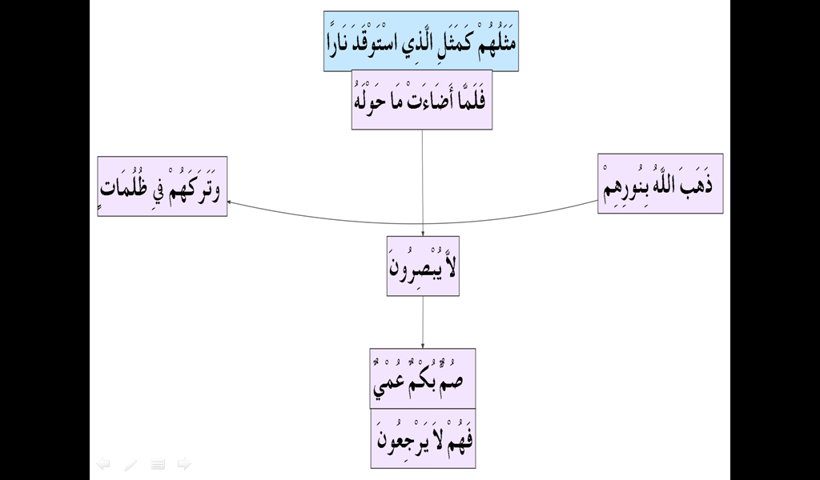

Slide 18
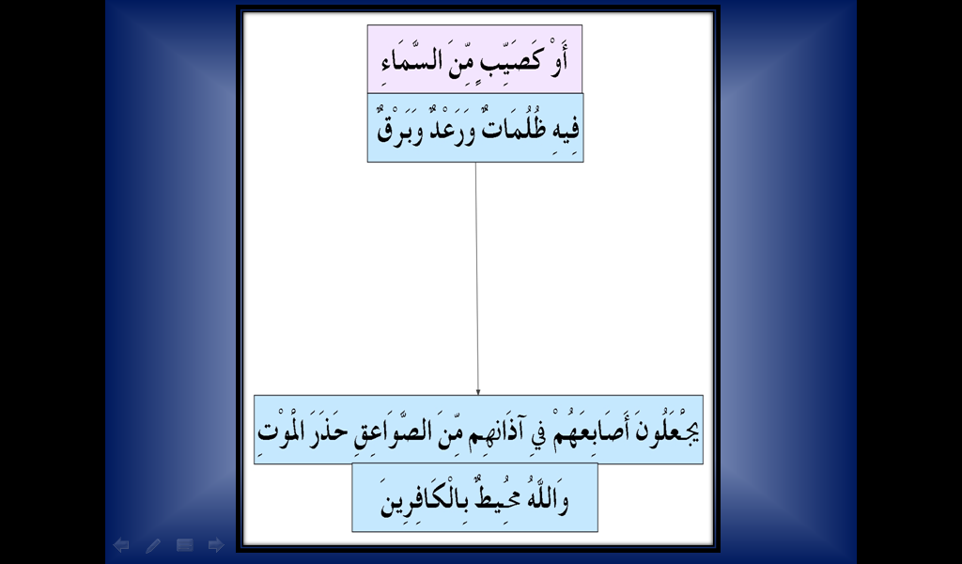

Slide 19
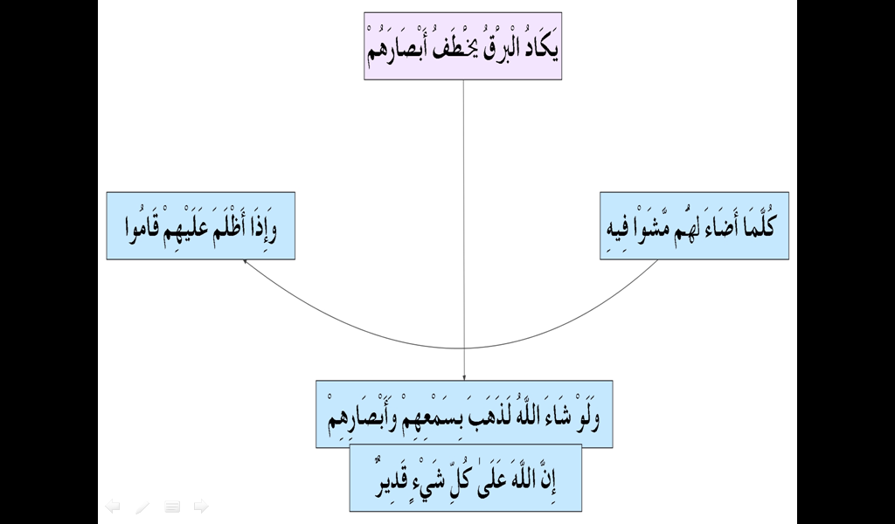

Slide 20
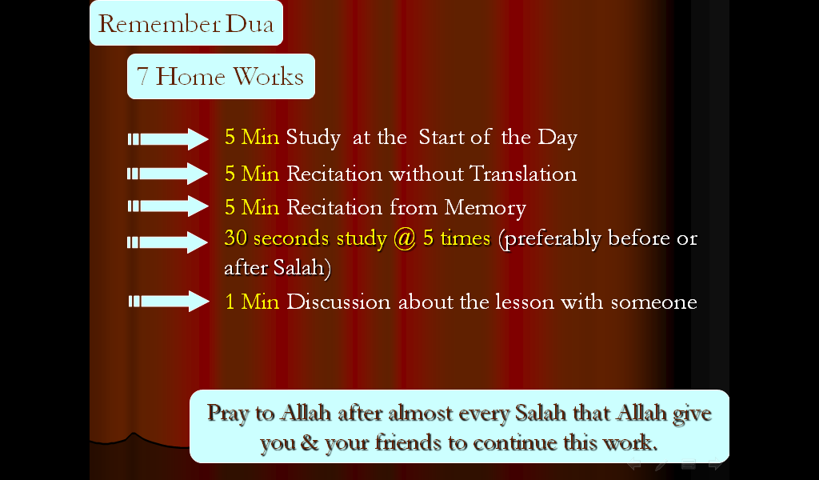

Slide 21
