Slide 1



Welcome to NurulQuran
Classroom
Rules & Regulations

Slide 2



Check list before you come
Note book
Pen/stationary
Sticky notes
Current Para
Subject book
And your passion

Slide 3
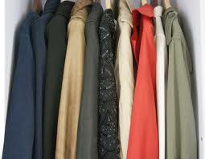

before entering the class
Ideal students
Put jackits in wardrobe
Switch off cell phone
Find their assigned seat
Come to seat 5 min earlier
Leave children to the babysitting room
Sign in on reception
Say Labbaik when role call calles

Slide 4
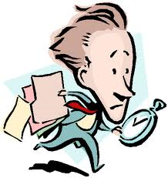
Entering when class is in progress
Avoide to say Salam
Just take a seat where it does not disturb rest of the class

Slide 5
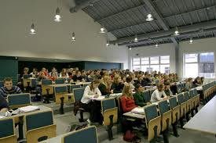
During the lecture
Signs of good students :
They do not eat or drink
If they have a question during the tafseer, they write it down and keep it with them.
Avoide non relevant questions
If they have to leave the class before it ends, they try to sit where it will not disturb rest of the class
They wants to absorve Quran that is why they do not think of Dunya or chat with other students.
They take notes

Slide 6

Student responsibilities
Students are expected to show a polite and respectful attitude towards other students and school staff.
Students are expected to be honest.
Foul language will not be tolerated.
Students must not litter or deface school property.
Be ready for next section when Labbaik plays

Slide 7

Students BEHAVIOR TO teacher
Give full credit to teacher and consider her to be a master
Show utmost respect to teacher
Listen carefully and follow
Be patient
Be humble
Ask for permission
Do not offer anything to teacher or put your hand on shoulder
Do not interupt while teacher is talking

Slide 8
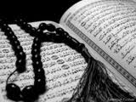
IMAAM Mujahid said:
Knowledge will never be gained by one who is shy or one who is arrogant.

Slide 9

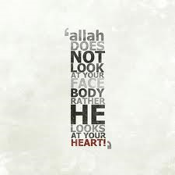
Attiquetes of knowledge
Knowledge will not enter your heart before
you clean it for 4 characteristics
Jealousy
Showing off
conceit
and arrogance towards others
Clear your intentions
Give time
Be patient
Take benifit of your age and skills
Do not eat much before class
Give rest to your body and your ”nafs”
Be among students who also go with you in class

Slide 10

grupping
Stay in your assigned group
Be prepare for groupping
Start from right side to recite your Sabaq

Slide 11

after the class
Thanks Allah swt to be in Quran class
Make sure to leave your place clean
Do your home work and be ready for next class

Slide 12

May Allah swt makes this class easy for all of us and take banefit out of it as much as possible

