Slide 2
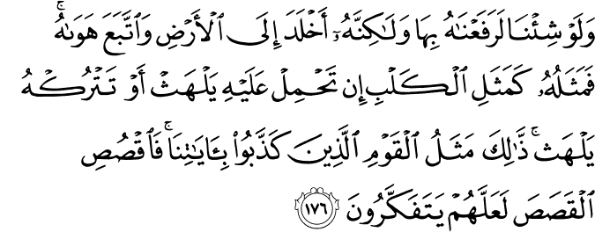
Surah Al-A’Araf

Slide 3
Translation
“And if We had willed, We would have lifted him on account of Our Signs, but he, clung to the earth and followed his desires, then his condition is like a dog, if you attack him, he brings his tongue out and if you leave him, he brings his tongue out. This is the condition of those who belied Our Signs. So you recount them the admonition haply they may ponder.”
(7:176)

Slide 4
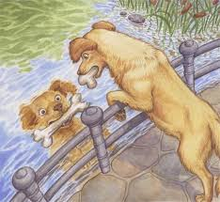
Greedy Dog
Dog is symbol of greediness. It wants to eat even it had fulfill its belly. The picture showing a dog looking its own reflection at stream. It had bone in mouth but while looking at stream it thought of another dog with bone in mouth. It’s just because of its endless greediness.

Slide 5
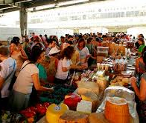
Man In Endless Desires
Same like that dog man have endless desires as he wants more and more. Human being always runs after world and forgets real purpose of life. Allah SWT resembled this type of man with dog and said Nabi SAW to share this incident with people so may they ponder upon that…
Allahumma La Taj’alna Minhum!!!

Slide 6
"‏اللهم إني أسألك حبك، وحب من يحبك، والعمل الذي يبلغني حبك، اللهم اجعل حبك أحب إلى من نفسي، وأهلي، ومن الماء البارد‏"الترمذي

Slide 7
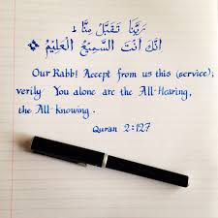
Created By: Naila Kayani

