Slide 1
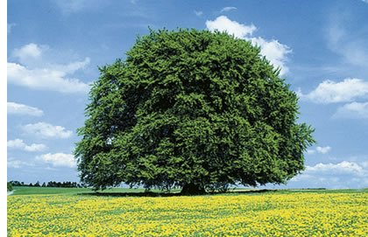
Ayaat - e - Birr
(Surah Baqarah :177)
Righteousness is not that you turn your faces toward the east or the west, but [true] righteousness is [in] one who believes in Allah, the Last Day, the angels, the Book, and the prophets and gives wealth, in spite of love for it, to relatives, orphans, the needy, the traveler, those who ask [for help], and for freeing slaves; [and who] establishes prayer and gives zakah; [those who] fulfill their promise when they promise; and [those who] are patient in poverty and hardship and during battle. Those are the ones who have been true, and it is those who are the righteous.

Slide 2
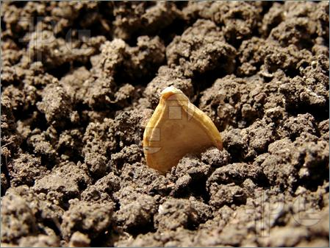
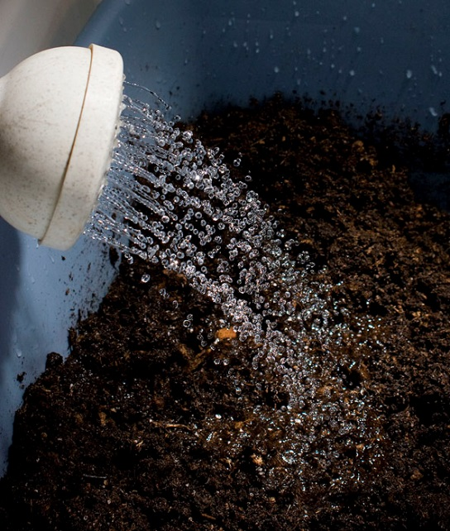
Love of Allah in Momin’s heart sprouts with the knowledge from Quran and Hadith.
Seed : Love of Allah
Soil: Momin’s Heart
Water: “ilm” from Quran and Hadith

Slide 3
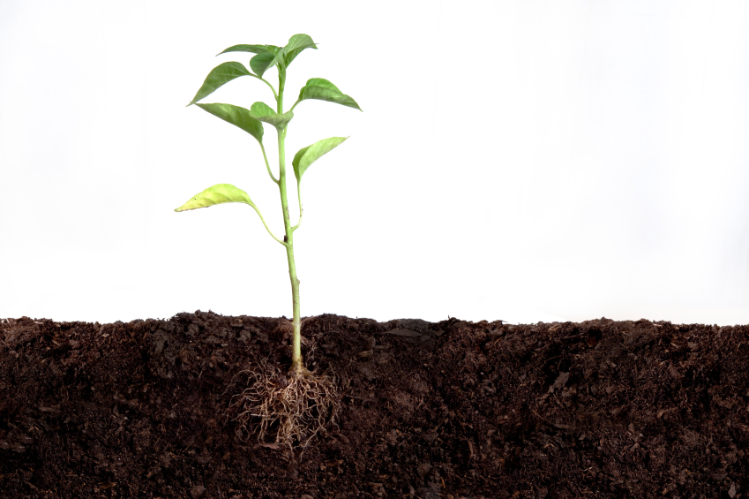

Increase in love for Allah, belief in Akhirah, Allah’s Rasools, Books and Angels , supports the growing righteousness.
Leaves : Akhlaq
Roots : Aqeedah

Slide 4
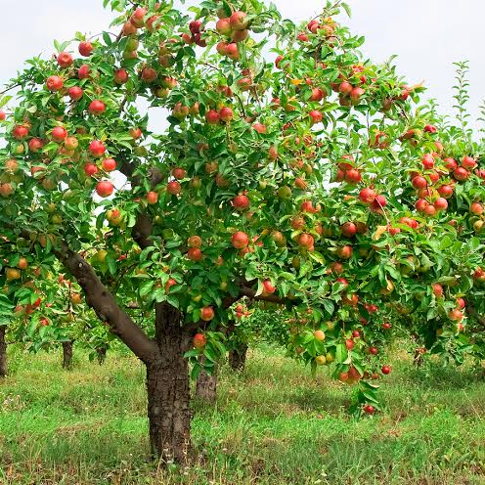
Imaan is strengthened through righteous deeds of giving zakat ,establishing Salat, fulfilling people’s rights and showing sabr at all times.
Fruits : Fruits of Imaan.
Branches :Rights of People

Slide 5

End result is path to peace ,leading to Jannah.
Nur_ZM78_Muslimah

